Slide 1

Cellular Chassis
presented by Dr. Natalie Kuldell
with slides from (and thanks to!)
Dr. Barry Canton, Ginkgo BioWorks

Slide 2
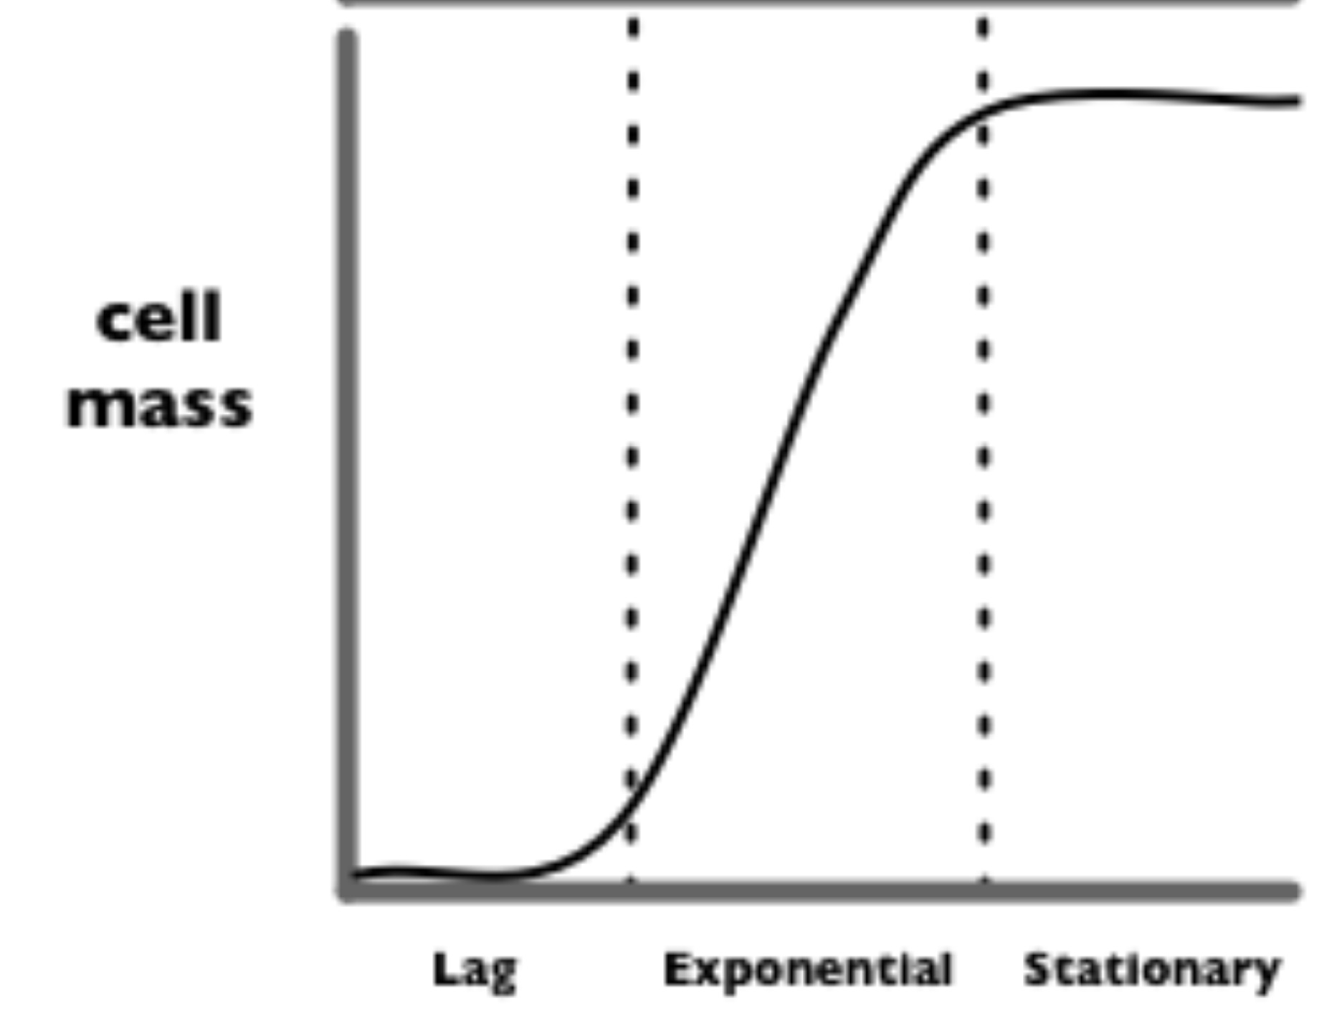
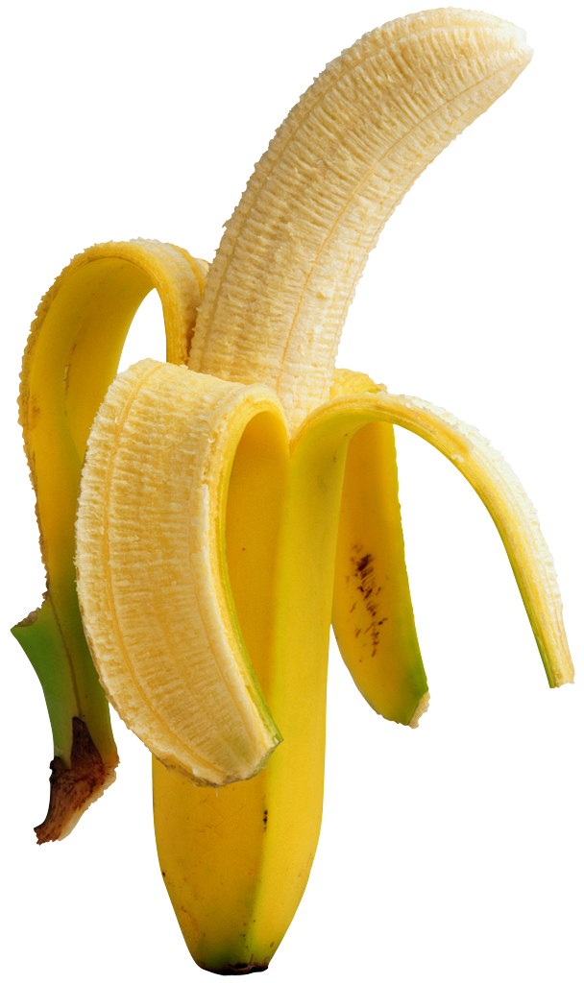
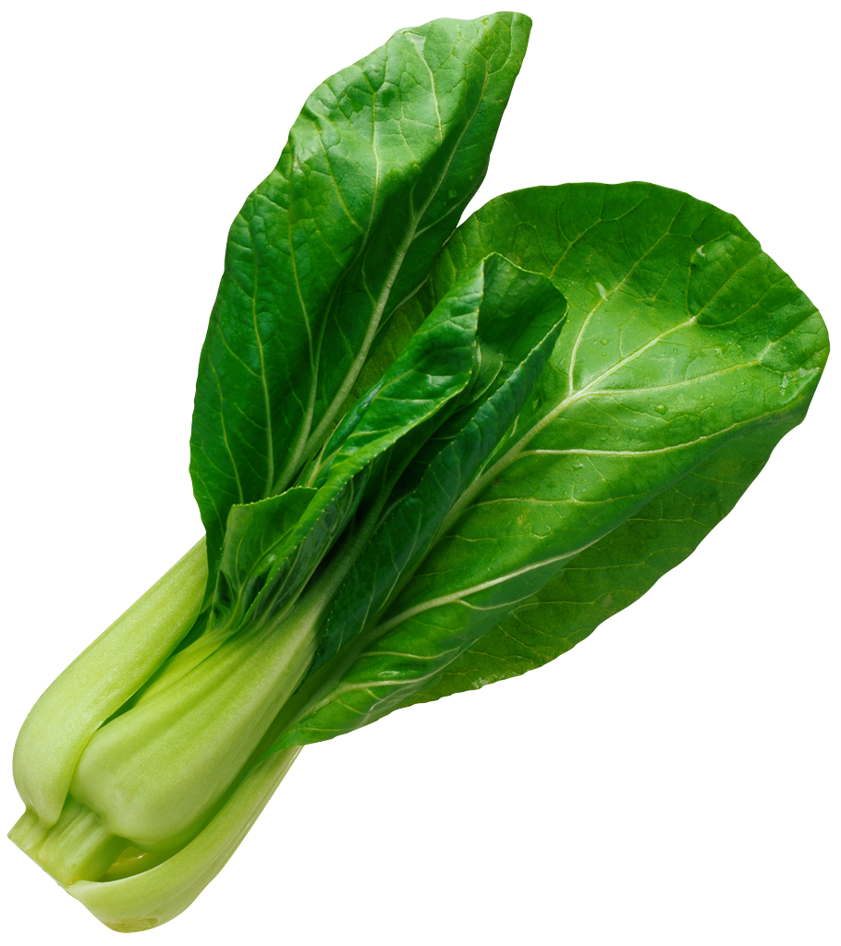


“Eau d’coli”
“stationary”
cell density
“log”
saGD
WGD
“lag”
iaGD
BGD
time
Notes:
http://parts.mit.edu/movies/iGEM2006_MIT.mov

Slide 3
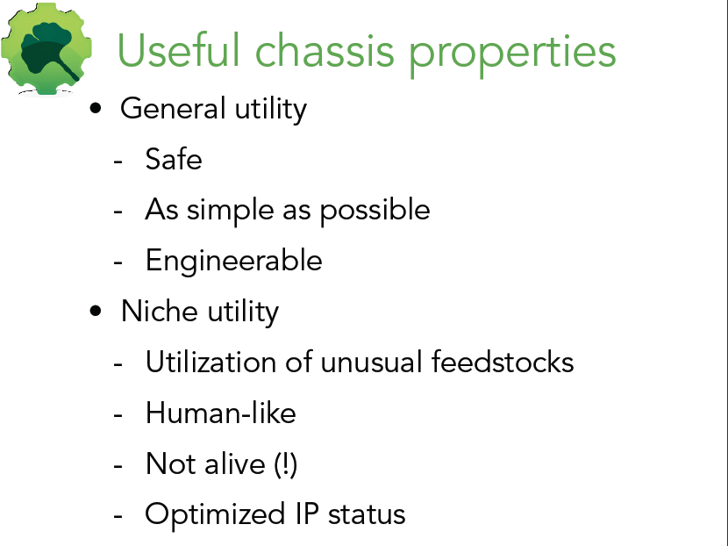
slides from Dr. Barry Canton, Ginkgo BioWorks

Slide 4
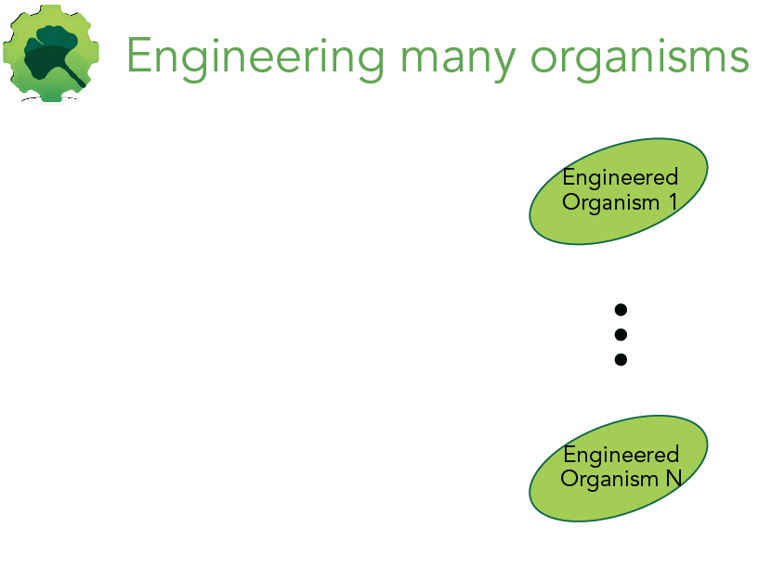

Slide 5
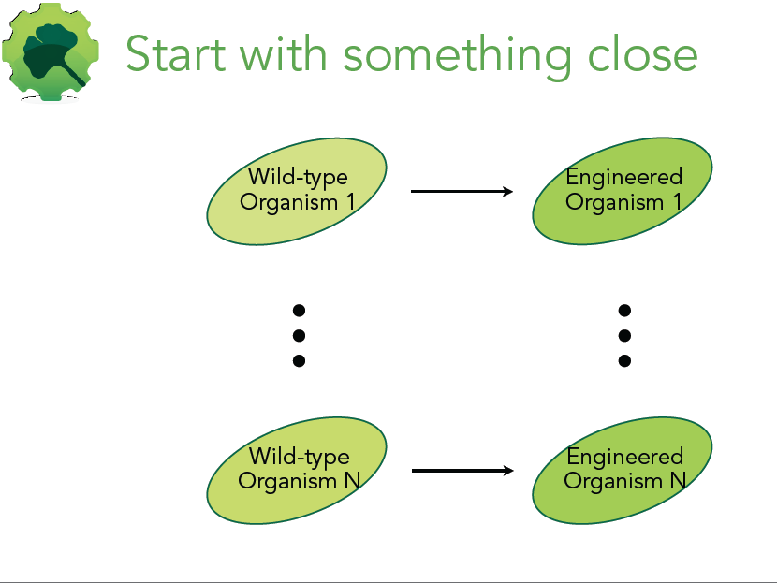

Slide 6
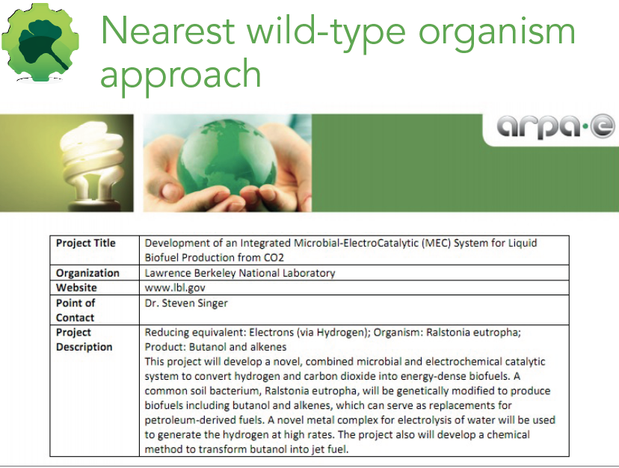

Slide 7
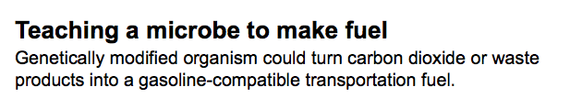
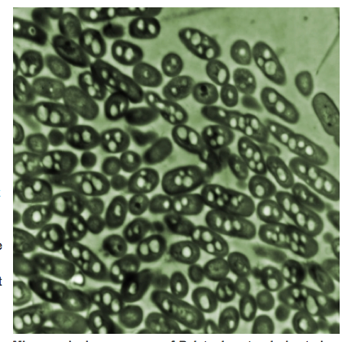

“What it does is take whatever carbon is available, and stores it in the form of a polymer, which is similar in its properties to a lot of petroleum-based plastics,” Brigham says.
Ralston eutropha
Notes:
It has long been the model organism for the study of polyhydroxybutyrate (PHB) biosynthesis. Under nutrient stress in the presence of excess carbon source, wild-type R. eutropha can accumulate approximately 80 % of its cell dry weight (CDW) as PHB, an intracellular carbon storage material (Budde et al. 2011; Yang et al. 2010). This intracellular polymer can be isolated from the cell and processed into biodegradable and biocompatible plastic for various applications (Rehm 2003; Brigham and Sinskey 2012). Uniquely, R. eutropha also contains two carbon-fixation Calvin–Benson–Bassham cycle operons, two oxygen-tolerant hydrogenases, and several formate dehydrogenases and has been studied extensively for its ability to fix carbon dioxide into complex cellular molecules while obtaining energy from hydrogen or formate oxidation under ambient oxygen concentration conditions (Bowien and Kusian 2002; Ishizaki et al. 2001; Lenz et al. 2010; Pohlmann et al. 2006; Schwartz et al. 2009). Recently, Li et al. (2012) constructed a system that couples electrochemical generation of formate with CO₂ fixation and the addition of heterologous genes for the conversion of formate to isobutanol and 3-methyl-1-butanol by R. eutropha. Via this electromicrobial conversion, over 140 mg/L branched-chain alcohols were synthesized in engineered R. eutropha strains (Li et al. 2012).

Slide 8
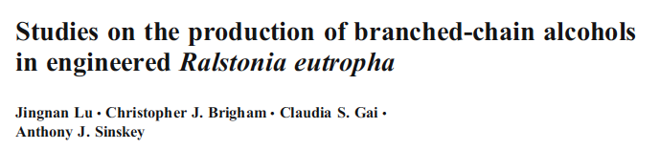
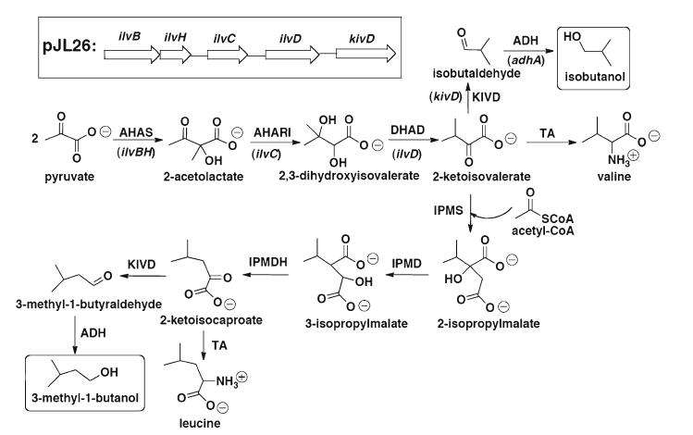
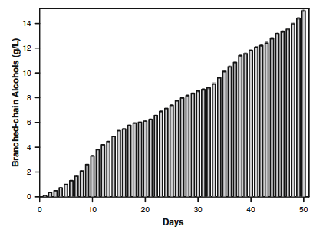

Isobutanol and 3-methyl-1-butanol production pathways
Branched-OH production (g/L)
Days
Notes:
It has long been the model organism for the study of polyhydroxybutyrate (PHB) biosynthesis. Under nutrient stress in the presence of excess carbon source, wild-type R. eutropha can accumulate approximately 80 % of its cell dry weight (CDW) as PHB, an intracellular carbon storage material (Budde et al. 2011; Yang et al. 2010). This intracellular polymer can be isolated from the cell and processed into biodegradable and biocompatible plastic for various applications (Rehm 2003; Brigham and Sinskey 2012). Uniquely, R. eutropha also contains two carbon-fixation Calvin–Benson–Bassham cycle operons, two oxygen-tolerant hydrogenases, and several formate dehydrogenases and has been studied extensively for its ability to fix carbon dioxide into complex cellular molecules while obtaining energy from hydrogen or formate oxidation under ambient oxygen concentration conditions (Bowien and Kusian 2002; Ishizaki et al. 2001; Lenz et al. 2010; Pohlmann et al. 2006; Schwartz et al. 2009). Recently, Li et al. (2012) constructed a system that couples electrochemical generation of formate with CO₂ fixation and the addition of heterologous genes for the conversion of formate to isobutanol and 3-methyl-1-butanol by R. eutropha. Via this electromicrobial conversion, over 140 mg/L branched-chain alcohols were synthesized in engineered R. eutropha strains (Li et al. 2012).

Slide 9
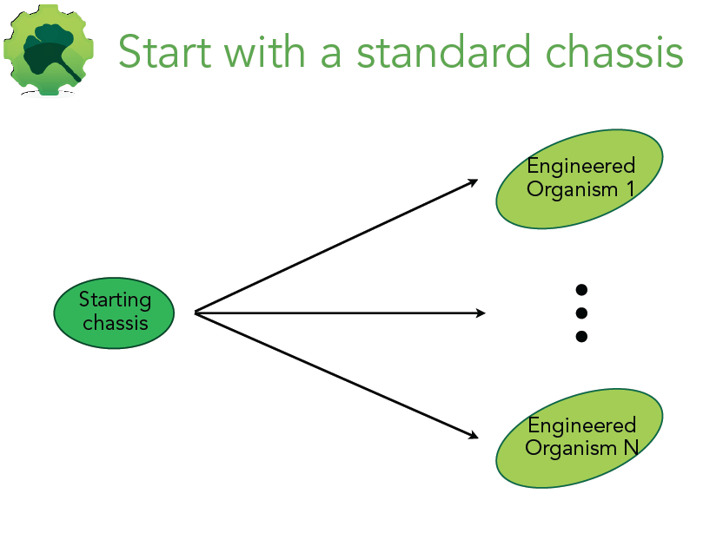

Slide 10
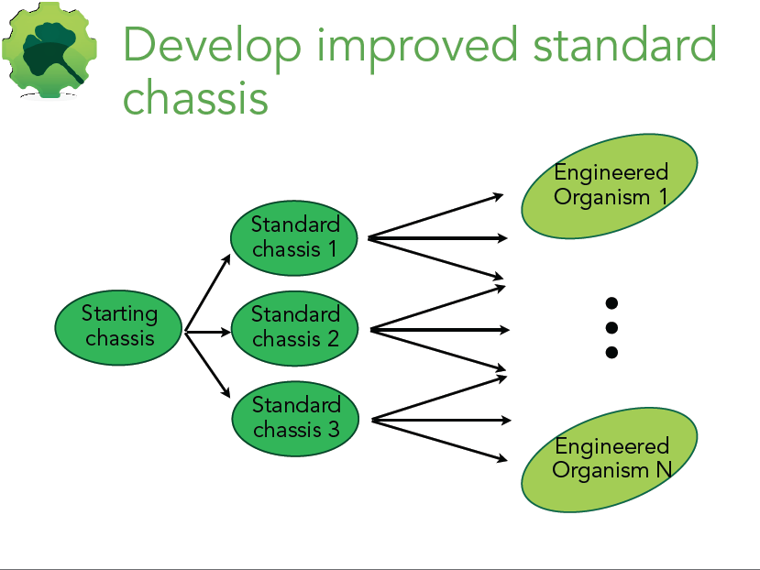

Slide 11
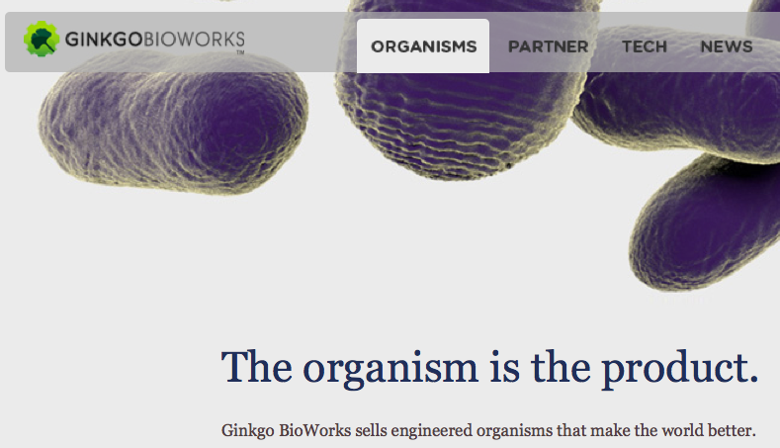

Slide 12
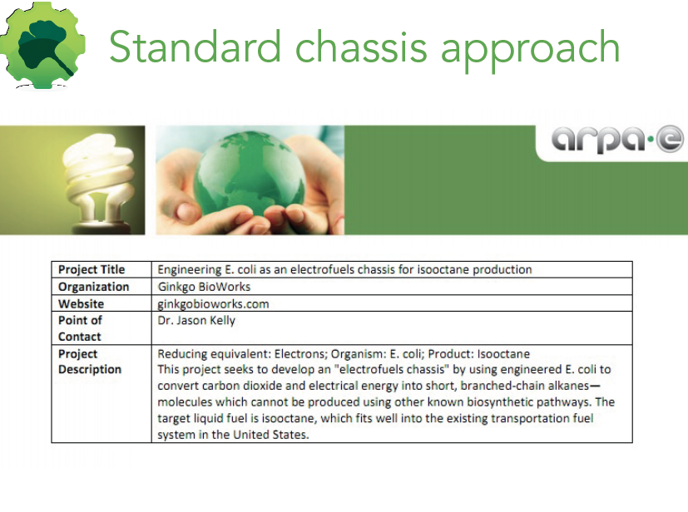

Slide 13

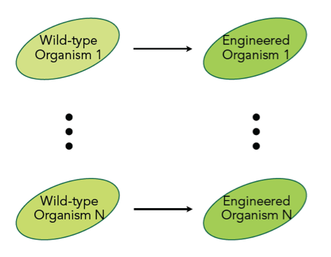

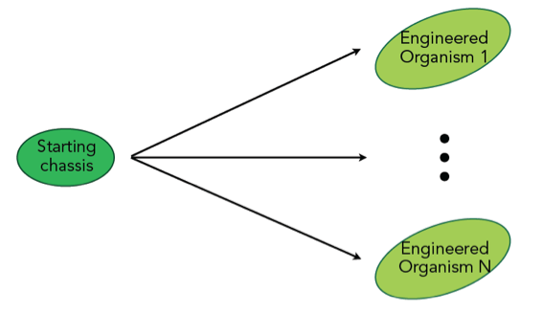

Slide 14
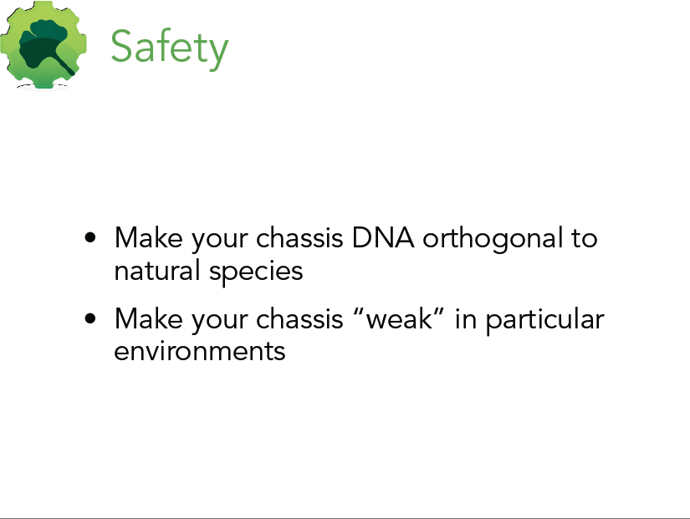

Slide 15
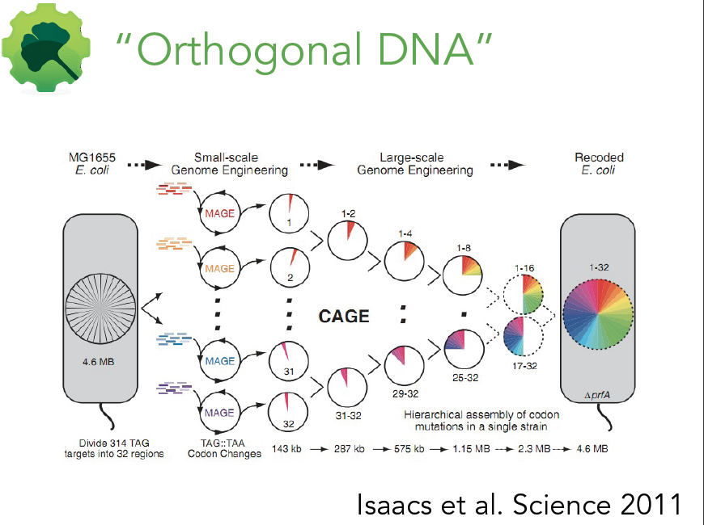

Slide 16
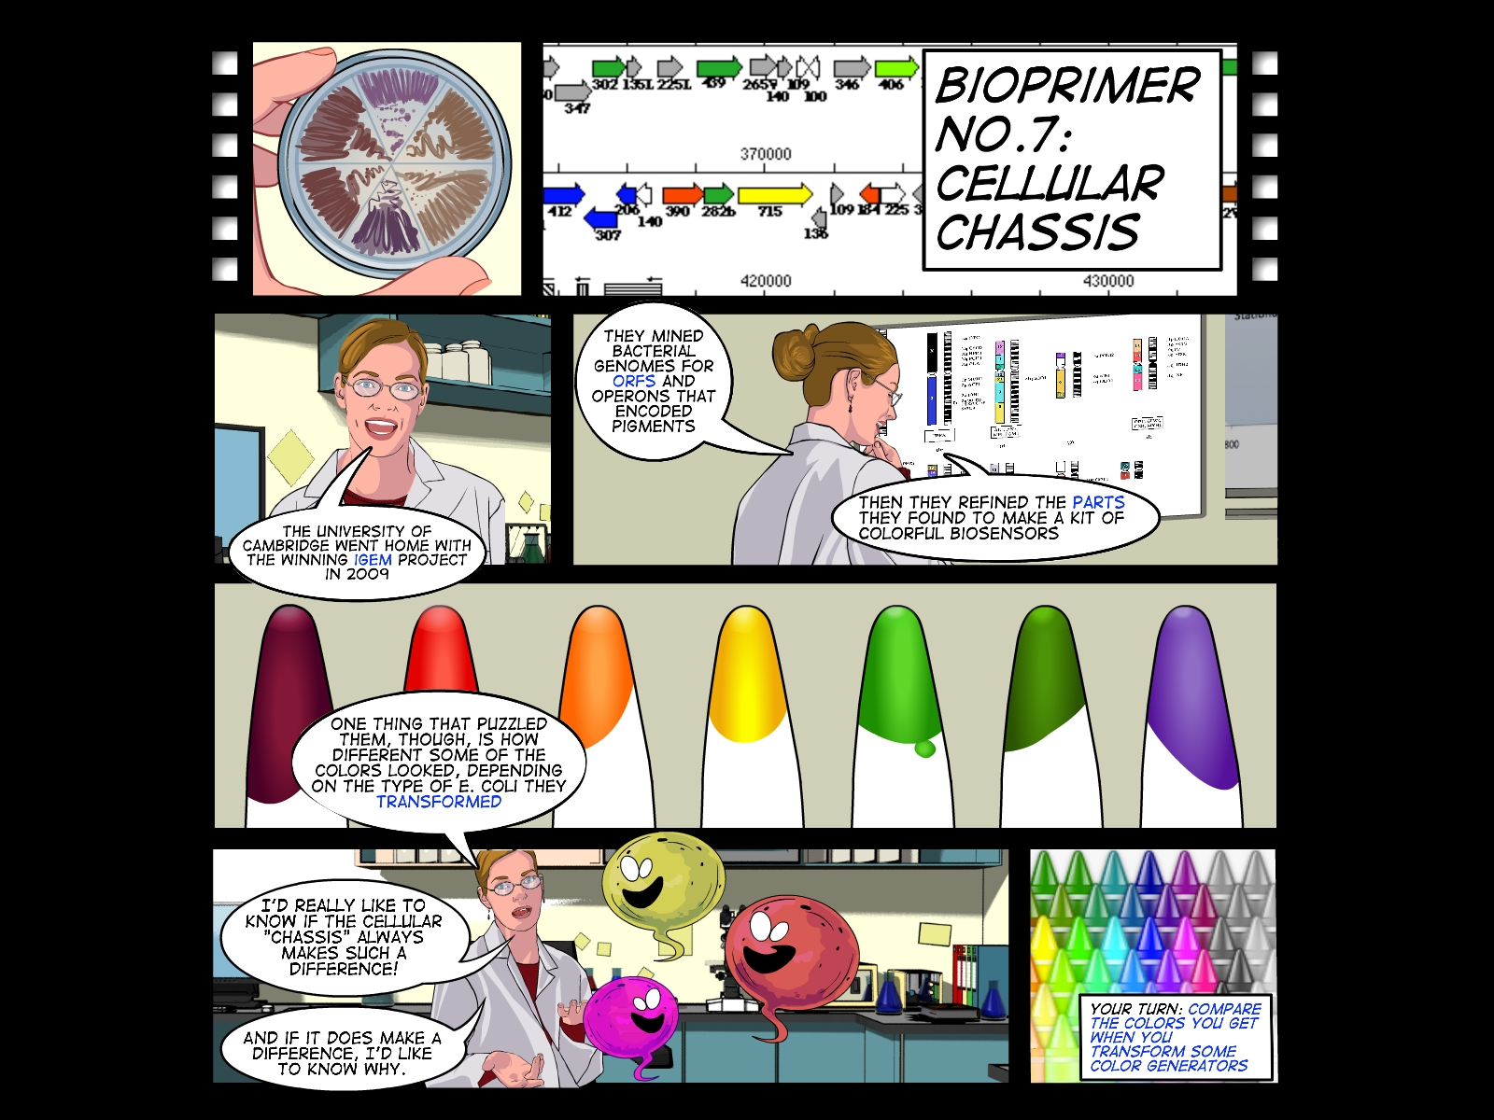

Slide 17
Cellular Chassis
presented by Dr. Natalie Kuldell
with slides from (and thanks to!)
Dr. Barry Canton, Ginkgo BioWorks

