Slide 1
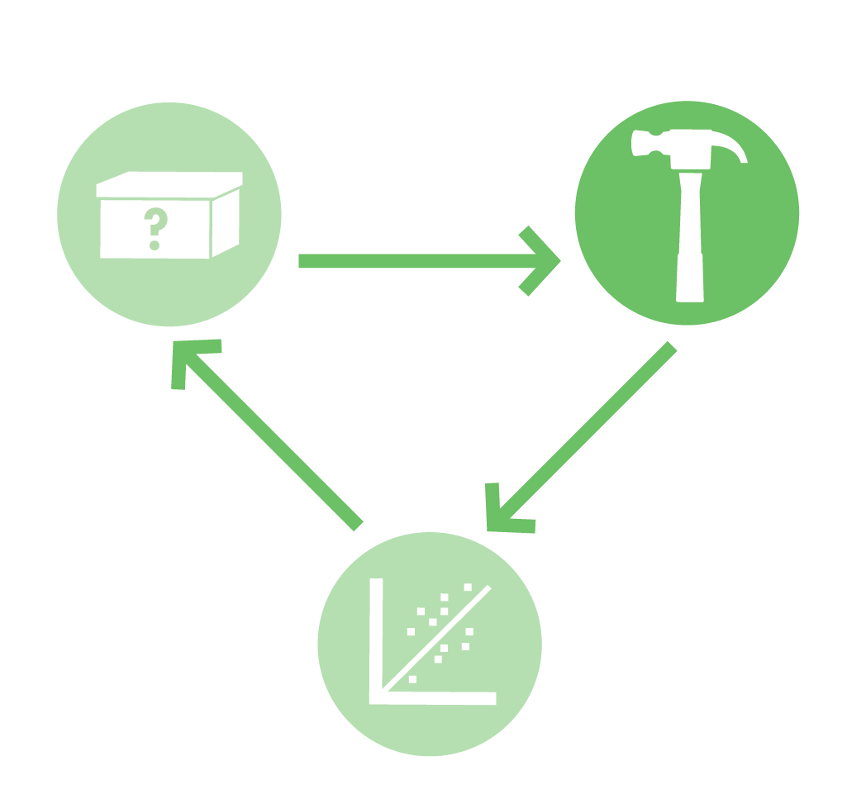
Golden Bread
Explores the science, engineering and bioethics of a yeast that’s genetically modified to make a vitamin-enriched food. Lab activities include PCR, yeast transformation, codon shuffling and statistical analysis of data
BioBuilder.org

Slide 2
Synthetic Biology
Synthetic Biology uses genetic engineering techniques to construct synthetic living systems
The synthetic biology approach familiarizes teachers and students with
molecular biology
genetic engineering
microbiology methods
ALL IN AN ENGINEERING SETTING
Golden Bread | BioBuilder.org

Slide 3
Synthetic Biology: Engineering Principles
These principles and technologies extend the teaching of molecular techniques into real world, authentic applications
Golden Bread | BioBuilder.org

Slide 4
Design
Build
Test
Golden Bread | BioBuilder.org

Slide 5
What A Colorful World
Examines the role of the cellular chassis in system performance. Students transform different strains of E. coli with DNA that turns the cells several bright colors. Students then observe how different the color intensity can be from strain to strain, despite being encoded by the same DNA sequence.
iTUNE Device
Examines the role of parts, such as promoters and ribosome binding sites, in predicting the output of a genetic device. The students measure β-galactosidase enzymatic activity as the device’s output, thereby looking through the lens of molecular genetics to predict and then evaluate a device’s behavior.
Picture This
Three activities to explore the role of modeling in circuit design. These activities include a downloadable program to computationally vary the parameters of a genetic circuit, an exercise to mimic a genetic circuit with electronic parts, and an opportunity to send a stencil that will be turned into a bacterial photograph.
Eau That Smell
Compares two alternative genetic designs. Both programs should make the cells smell like ripe bananas as the cells grow.
Golden Bread
Explores the science, engineering and bioethics of a yeast that’s genetically modified to make a vitamin-enriched food. Lab activities include PCR, yeast transformation, codon shuffling and statistical analysis of data
Golden Bread | BioBuilder.org

Slide 6
Golden Bread
This lab focuses on a strain of baker’s yeast that has been modified to produce β-carotene, a nutrient we naturally obtain from eating foods such as carrots, sweet potatoes, and broccoli.
Golden Bread | BioBuilder.org

Slide 7
Golden Bread
In the body, β-carotene is converted to vitamin A, which is crucial for vision, the immune system, and other biological functions.
Golden Bread | BioBuilder.org

Slide 8
Golden Bread
Researchers hope that an engineered strain of baker’s yeast designed to generate β-carotene could be used in bread to treat vitamin A deficiency. The Golden Yeast was developed as part of an iGEM Project called ‘VitaYeast.” The iGEM team extended some work published in 2007 by researchers who genetically manipulated baker’s yeast, the strain known as Saccharomyces cerevisiae.
Golden Bread | BioBuilder.org

Slide 9
Golden Bread
The metabolic pathway for making Vitamin A consists of three enzymes that convert farnesyl phosphate to β-carotene, which then spontaneously breaks in half to become Vitamin A.
Golden Bread | BioBuilder.org

Slide 10
Golden Bread
Nature has provided a simple way to detect pigments produced by this pathway. The first three compounds in this pathway are colorless, but the last three are colored yellow, red, and orange, respectively. Yeast making β-carotene turn bright orange while yeast making lycopene turn red like a tomato, which has a naturally high lycopene concentration. Finally, neurosporene is a yellow intermediate in this pathway. White colonies may have lost one or more of the crt genes.
Golden Bread | BioBuilder.org

Slide 11
Golden Bread
Researchers knew they had successfully added the three β-carotene biosynthesis genes into baker’s yeast, S. cerevisiae, because they saw that the normally white-colored cells were grew as orange colonies.
Golden Bread | BioBuilder.org

Slide 12
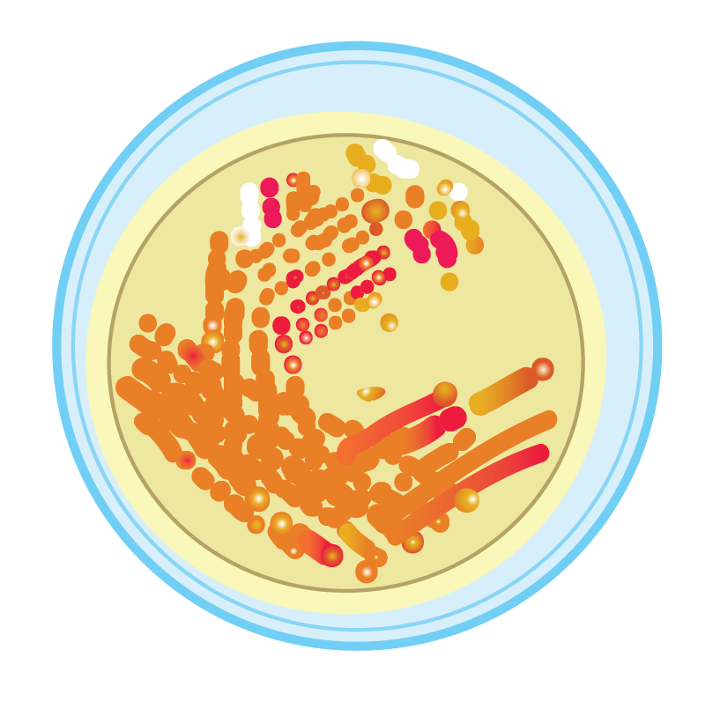
Golden Bread
Much to the researcher’s disappointment, though, the strain was not orange 100 percent of the time.
When streaked out on a petri dish, the engineered yeast strain grew as orange colonies most of the time, but they could also see red, yellow, and white colonies, indicating that some of the steps in the pathway were not working.
Golden Bread | BioBuilder.org

Slide 13
Engineering Toolbox Concept 1: Mean Time to Failure
The mean time to failure helps designers predict when a system will break. It also guides the designer on when and how to intervene through regular maintenance of the system. Engineers include MTF calculations in their design process so that they can recommend when parts should be serviced and how to use them for greatest longevity.
Golden Bread | BioBuilder.org

Slide 14
Engineering Toolbox Concept 1: Mean Time to Failure
A paperclip’s MTF: Bending a paperclip back and forth, as shown here, will eventually cause it to break. The number of bends before breaking can be used to calculate MTF.
Golden Bread | BioBuilder.org

Slide 15
Engineering Toolbox Concept 2: Redundancy
Building redundancy into an engineered system is another technique used in many fields to ensure more reliable performance.Redundancy in living cells is also important for their survival. DNA can be damaged by mutagens in the cell’s environment, inducing changes in the DNA sequence and making some of the genetic instructions essentially unreadable. Having two copies of the genome is a natural form of genetic redundancy and provides the cell with some insurance.
Golden Bread | BioBuilder.org

Slide 16
Engineering Toolbox Concept 2: Redundancy
By adding suspenders to a belt, you can be extra confident that there will be no wardrobe malfunctions.
Golden Bread | BioBuilder.org

Slide 17
Experimental Method
Golden Bread | BioBuilder.org

Slide 18
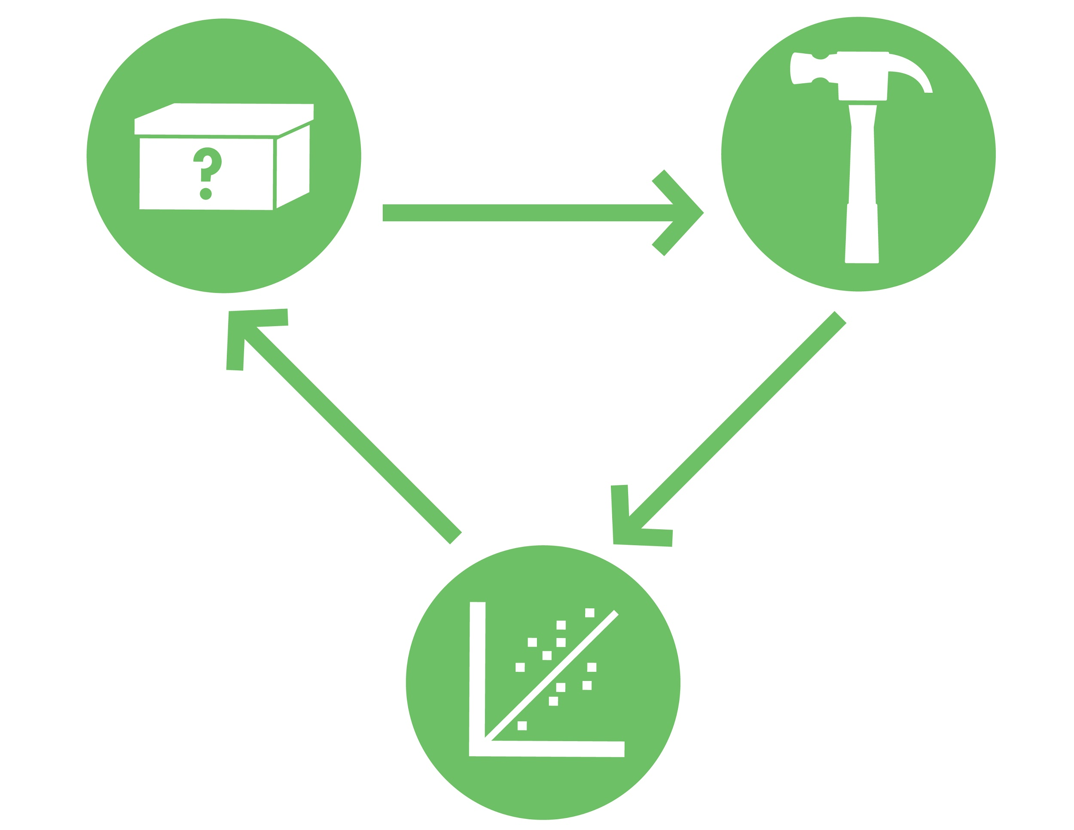
Good Luck!
BioBuilder.org

