Slide 1
Developed in collaboration with
Golden Bread
Explores the science, engineering and bioethics of a yeast that’s genetically modified to make a vitamin-enriched food. Lab activities include PCR, yeast transformation, codon shuffling and statistical analysis of data
BioBuilder.org

Slide 2
Synthetic Biology
Synthetic Biology uses genetic engineering techniques to construct synthetic living systems
The synthetic biology approach familiarizes teachers and students with
molecular biology
genetic engineering
microbiology methods
ALL IN AN ENGINEERING SETTING
Golden Bread | BioBuilder.org

Slide 3
Synthetic Biology: Engineering Principles
These principles and technologies extend the teaching of molecular techniques into real world, authentic applications
Golden Bread | BioBuilder.org

Slide 4
Design
Build
Test
Golden Bread | BioBuilder.org

Slide 5
What A Colorful World
Examines the role of the cellular chassis in system performance. Students transform different strains of E. coli with DNA that turns the cells several bright colors. Students then observe how different the color intensity can be from strain to strain, despite being encoded by the same DNA sequence.
iTUNE Device
Examines the role of parts, such as promoters and ribosome binding sites, in predicting the output of a genetic device. The students measure β-galactosidase enzymatic activity as the device’s output, thereby looking through the lens of molecular genetics to predict and then evaluate a device’s behavior.
Picture This
Three activities to explore the role of modeling in circuit design. These activities include a downloadable program to computationally vary the parameters of a genetic circuit, an exercise to mimic a genetic circuit with electronic parts, and an opportunity to send a stencil that will be turned into a bacterial photograph.
Eau That Smell
Compares two alternative genetic designs. Both programs should make the cells smell like ripe bananas as the cells grow.
Golden Bread
Explores the science, engineering and bioethics of a yeast that’s genetically modified to make a vitamin-enriched food. Lab activities include PCR, yeast transformation, codon shuffling and statistical analysis of data
Golden Bread | BioBuilder.org

Slide 6
Golden Bread
This lab focuses on a strain of baker’s yeast that has been modified to produce β-carotene, a nutrient we naturally obtain from eating foods such as carrots, sweet potatoes, and broccoli.
Golden Bread | BioBuilder.org

Slide 7
Golden Bread
In the body, β-carotene is converted to vitamin A, which is crucial for vision, the immune system, and other biological functions.
Golden Bread | BioBuilder.org

Slide 8
Golden Bread
Researchers hope that an engineered strain of baker’s yeast designed to generate β-carotene could be used in bread to treat vitamin A deficiency. The Golden Yeast was developed as part of an iGEM Project called ‘VitaYeast.” The iGEM team extended some work published in 2007 by researchers who genetically manipulated baker’s yeast, the strain known as Saccharomyces cerevisiae.
Golden Bread | BioBuilder.org

Slide 9
Golden Bread
The metabolic pathway for making Vitamin A consists of three enzymes that convert farnesyl phosphate to β-carotene, which then spontaneously breaks in half to become Vitamin A.
Golden Bread | BioBuilder.org

Slide 10
Golden Bread
Nature has provided a simple way to detect pigments produced by this pathway. The first three compounds in this pathway are colorless, but the last three are colored yellow, red, and orange, respectively. Yeast making β-carotene turn bright orange while yeast making lycopene turn red like a tomato, which has a naturally high lycopene concentration. Finally, neurosporene is a yellow intermediate in this pathway. White colonies may have lost one or more of the crt genes.
Golden Bread | BioBuilder.org

Slide 11
Golden Bread
Researchers knew they had successfully added the three β-carotene biosynthesis genes into baker’s yeast, S. cerevisiae, because they saw that the normally white-colored cells were grew as orange colonies.
Golden Bread | BioBuilder.org

Slide 12
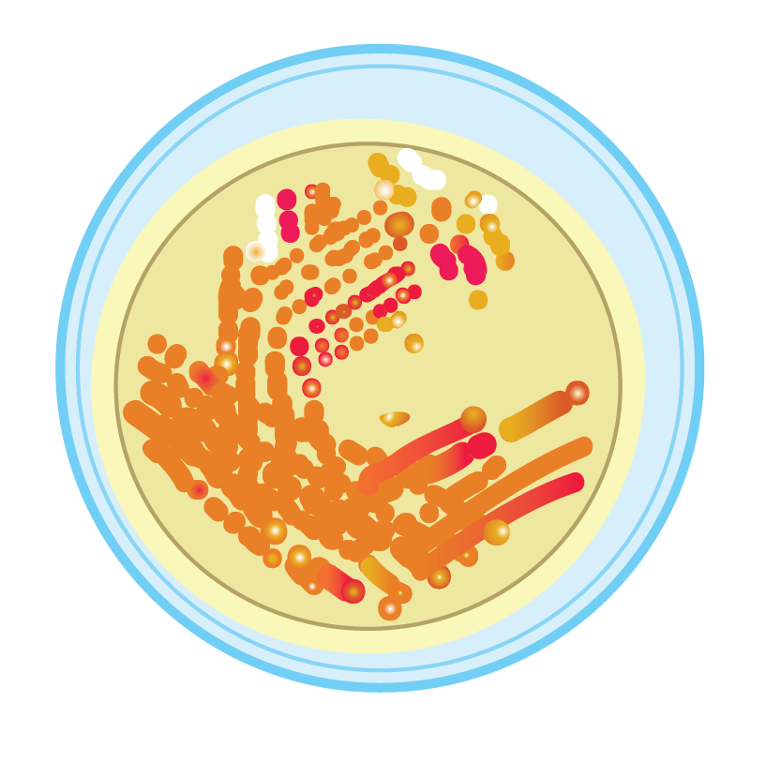
Golden Bread
Much to the researcher’s disappointment, though, the strain was not orange 100 percent of the time.
When streaked out on a petri dish, the engineered yeast strain grew as orange colonies most of the time, but they could also see red, yellow, and white colonies, indicating that some of the steps in the pathway were not working.
Golden Bread | BioBuilder.org

Slide 13
Molecular Biology Toolkit
With modern lab techniques it is now possible to explore and perhaps diagnose cellular defects at the molecular level. Three of the most crucial and well-established techniques of molecular biology help:
Read the DNA code, aka “sequence DNA”
Copy existing DNA sequences, a technique known as Polymerase Chain Reaction (PCR)
Insert specific DNA sequences into existing DNA strands, creating recombinant DNA
Golden Bread | BioBuilder.org

Slide 14
Molecular Biology Toolkit
These techniques weren’t invented from scratch. They exploit natural cellular processes in a way that can provide valuable information and raw materials for further study.
Golden Bread | BioBuilder.org

Slide 15
About PCR (Polymerase Chain Reaction)
Rare or unidentified biological samples can be studied and manipulated with PCR. The technique has been used in diverse and important ways such as:
Pathogen Detection
Genetic Modification
Forensic Analysis
DNA Sequencing
Golden Bread | BioBuilder.org

Slide 16
About PCR (Polymerase Chain Reaction)
?
}
In this experiment, PCR will be used to “find a needle in a haystack,” i.e. to detect and then copy one section of DNA from the long and complex yeast genome.
This detection feature will help you clarify what is “broken” (genetically speaking) in the engineered yeast that are not growing as orange colonies.
Golden Bread | BioBuilder.org

Slide 17
About PCR (Polymerase Chain Reaction)
The materials that go into a PCR experiment are remarkably simple. Reactions combine:
Template = the DNA to be studied
Primers = short snippets of DNA that specify where the replication should begin and end
DNA polymerase and nucleotides = an enzyme and its substrate to copy the DNA template
Buffer to maintain pH and provide ions for the reactions
Golden Bread | BioBuilder.org

Slide 18
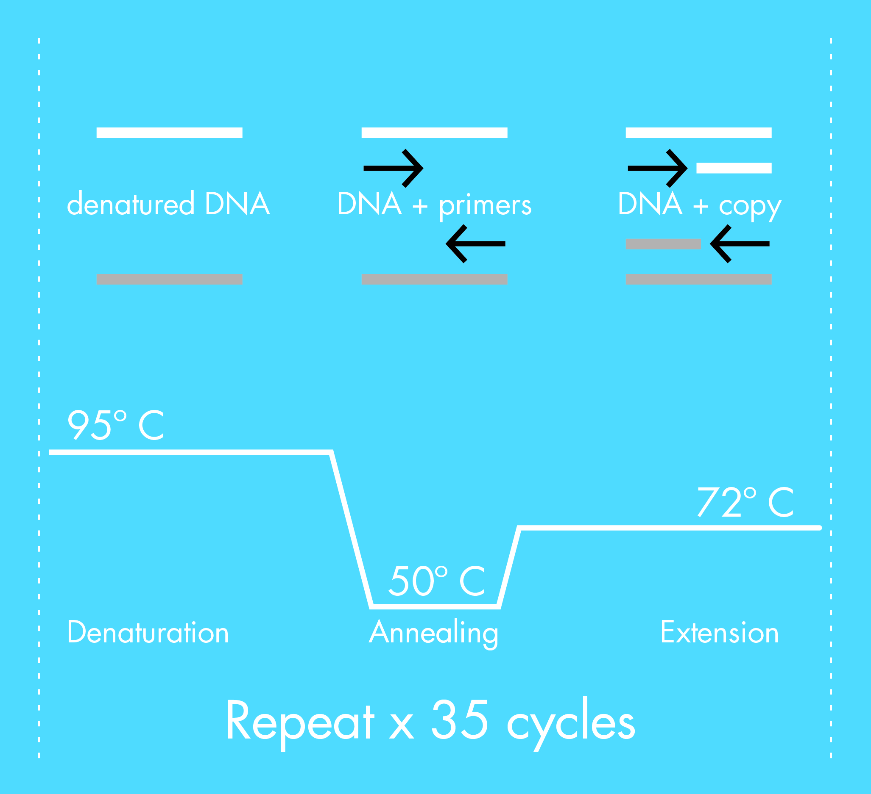
About PCR (Polymerase Chain Reaction)
The mixture is then cycled through different temperatures.
In the “denaturation step” the mixture is raised to a high temperature so that all the DNA bases unpair.
For the “annealing step,” the temperature is lowered, allowing the primers to bind to the template DNA.
Finally, the “extension step” raises the temperature slightly to allow the DNA polymerase to work.
This process is repeated dozens of times to create billions of copies of the desired DNA fragment.
Golden Bread | BioBuilder.org

Slide 19
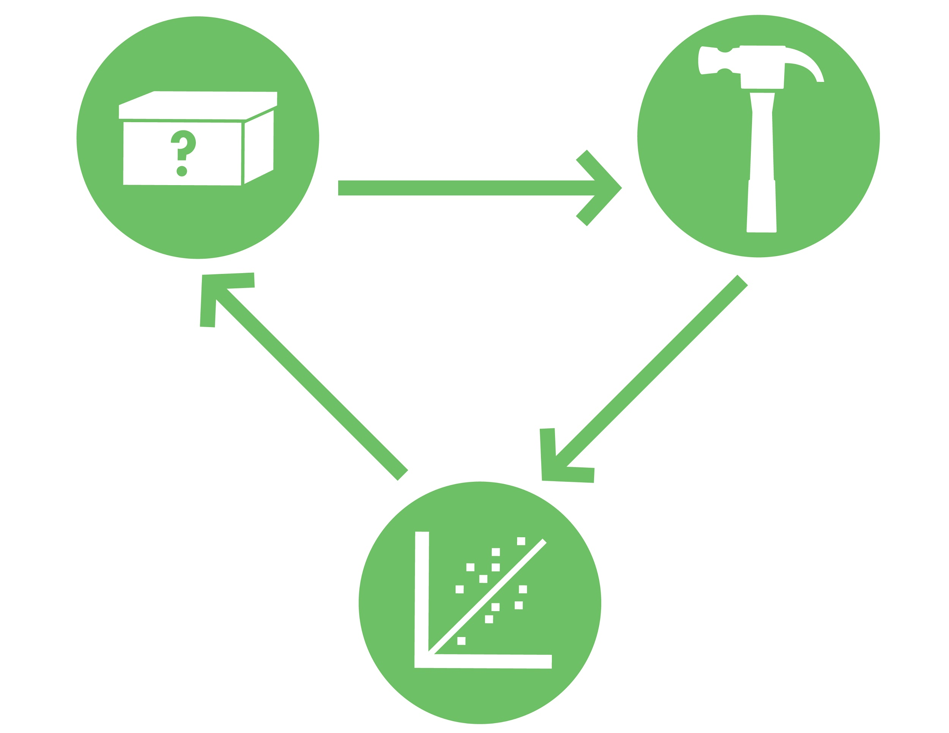
Developed in collaboration with
Good Luck!
BioBuilder.org

