Slide 1
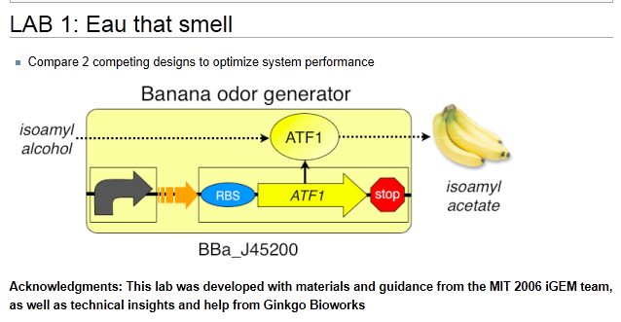

Slide 2
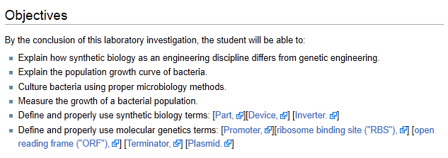

Slide 3
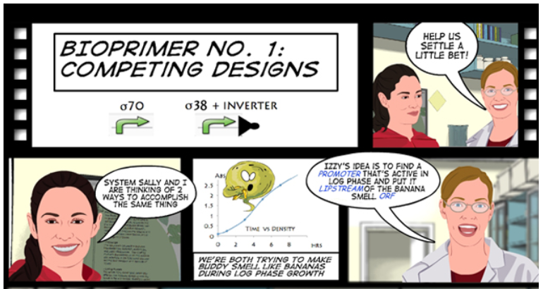

Slide 5
An engineering paradigm
Design
Test
The focus of this lab
Build

Slide 6
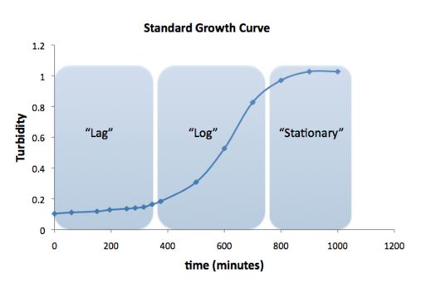
The Eau d’coli device designed by the 2006 iGEM team expresses
the banana smell during the stationary phase.
Why?

Slide 7
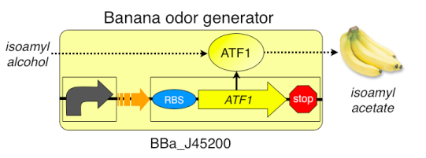
What happens in the original design?
What is the role of the promoter?
What is the role of the ATF1 ORF?
What is the role of the ATF1 enzyme?

Slide 8
There are two designs that could change this device to log phase expression:
Log phase promoter
Inverter + stationary phase promoter
Your challenge is to test both and see which works better.
Any educated guesses?

Slide 9
We have been sent 4 strains of E. coli. Each has a different device:
Strain 1-1 is the original Eau d’ coli device
Strain 1-2 has the original Eau d’coli device with an inverter
Strain 1-3 has the log phase promoter
Strain 1-4 has no smell generating device
Why should we test strains 1-1 and 1-4?

Slide 10
Protocol A:
We have prepared cultures of each strain:
For each strain we placed a sample in the refrigerator before it had time to incubate. This is the lag phase sample.
For each strain we let a sample run for 6 hours. This is the log phase sample.
For each strain we let a sample run overnight. This is the stationary phase.
There are 12 samples all together (4 cultures each at three time points).

Slide 11
For each sample you will measure:
The OD 600 using the spec 20. This will tell you the population of bacteria.
The banana smell by comparison with the banana standards
Be sure to replace the foil on the culture after smelling
Record your observations
does everyone in the group rate the smell the same?

Slide 12
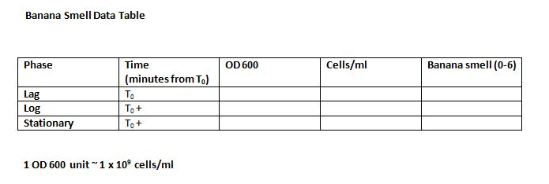
You will need to make 4 data tables like this, one for each strain

Slide 13
Protocol B:
You will prepare cultures of each strain:
Every 20 minutes you will take a sample from each culture
The OD 600 using the spec 20. This will tell you the population of bacteria.
The banana smell by comparison with the banana standards
Record your observation—does everyone in the group smell the same thing?
Be sure to replace the foil on the cultures after smelling

Slide 14
At the end of class the cultures will be refrigerated until tomorrow morning
Sampling will resume in class tomorrow and continue for another day
This will allow us to collect data from various parts of the growth curve
It is important to note the time after the cultures were started for each measurement you take

Slide 15
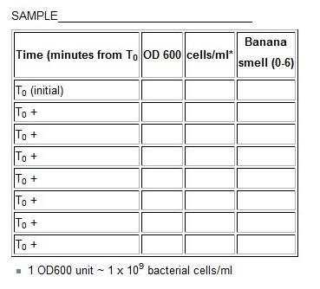
You will need to make 4 data tables like this, one for each strain

