Slide 1

Introduction to Synthetic Biology
presented by Dr. Natalie Kuldell

Slide 2
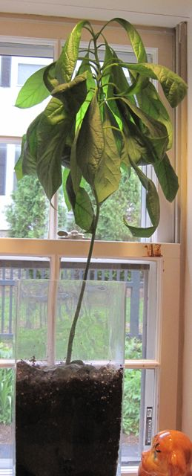

Slide 3


Slide 4
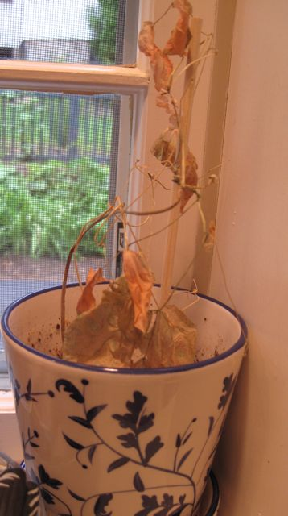

Slide 5
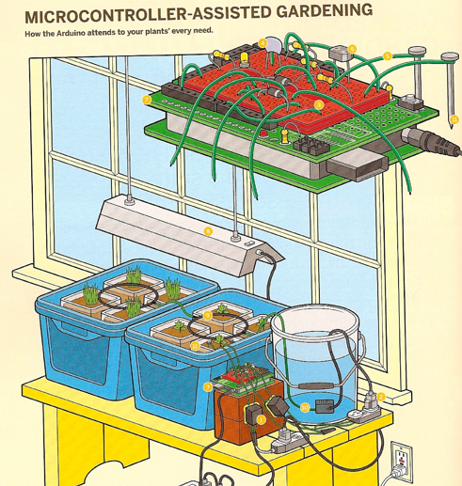
ELECTRICAL engineering solution

Slide 6
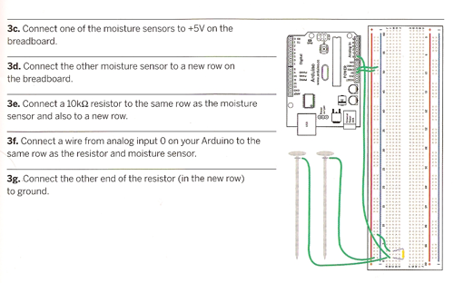

Slide 7
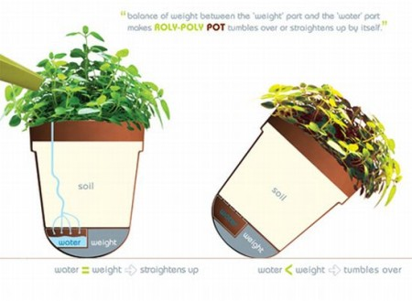
MECHANICAL engineering solution
water = weight water<weight

Slide 8
BIOLOGICAL engineering solution

Slide 9
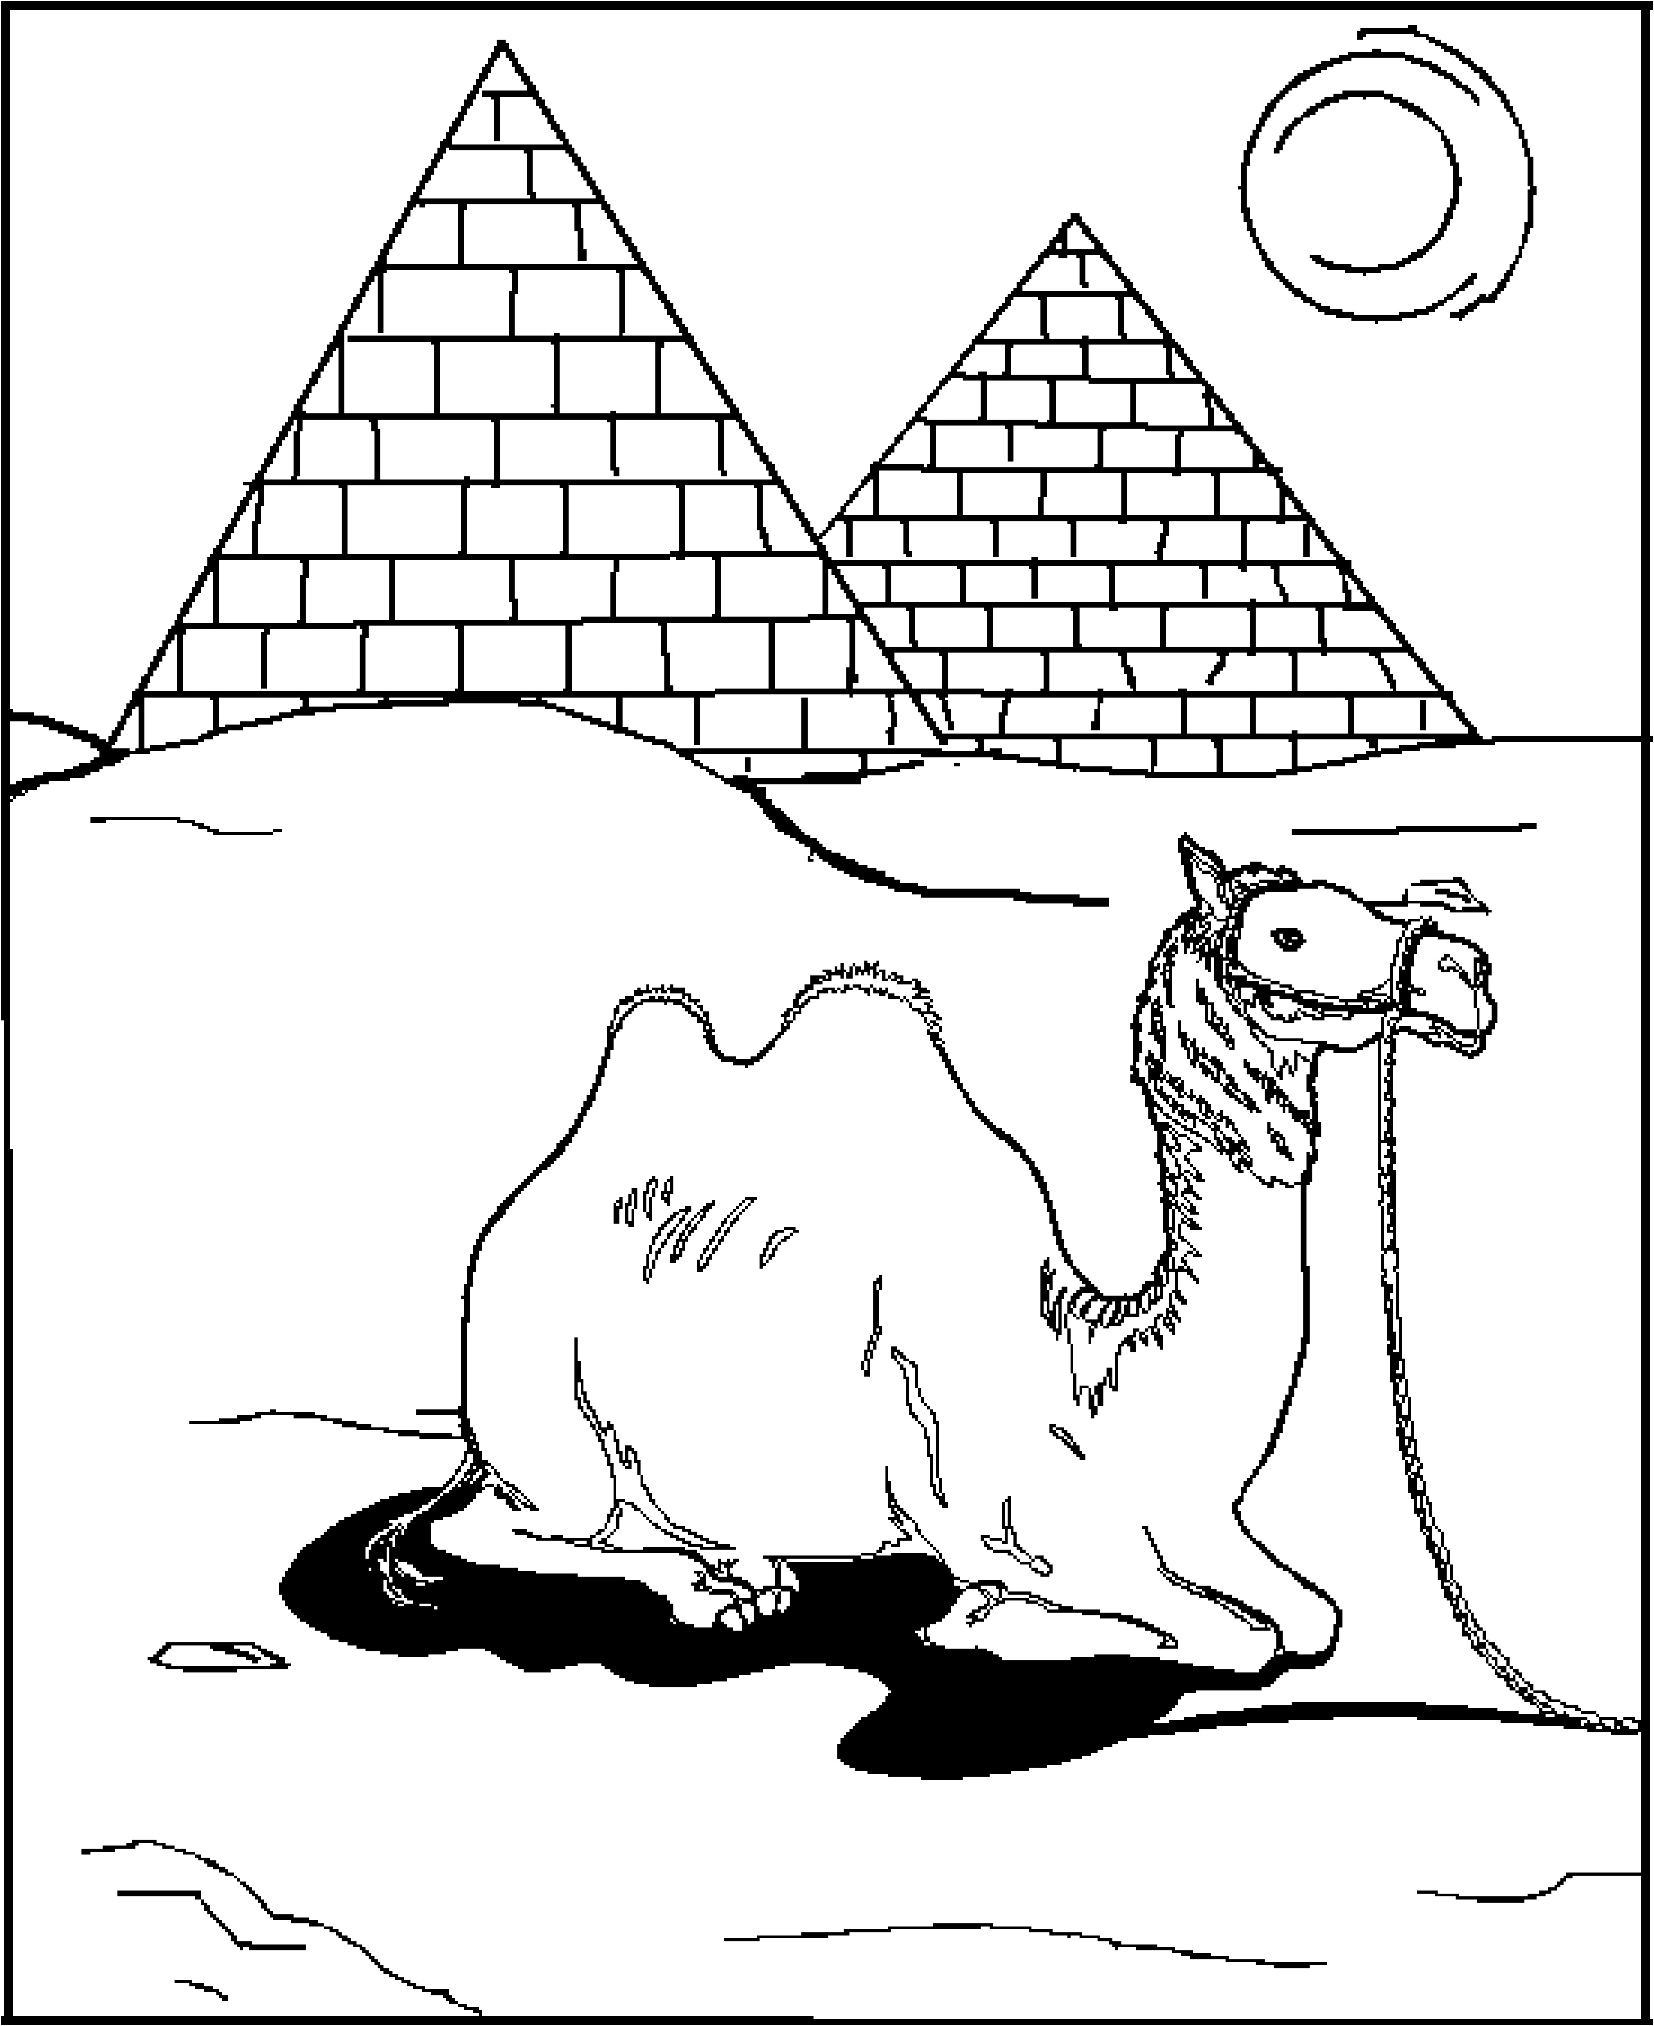
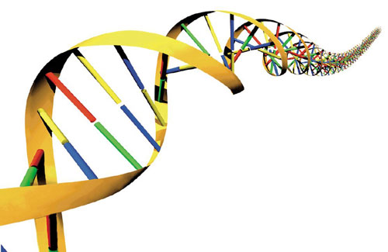
BIOLOGICAL engineering solution

Slide 10

BIOLOGICAL engineering solution

Slide 11


Genetic Engineering
rDNA
Sequencing
PCR

Slide 12


Slide 13



Slide 14
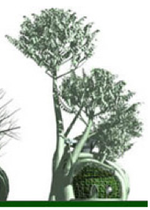

Synthetic Biology
Standardization
Abstraction
Synthesis
A+A+C+T+T…
Genetic Engineering
rDNA
Sequencing
PCR

Slide 15

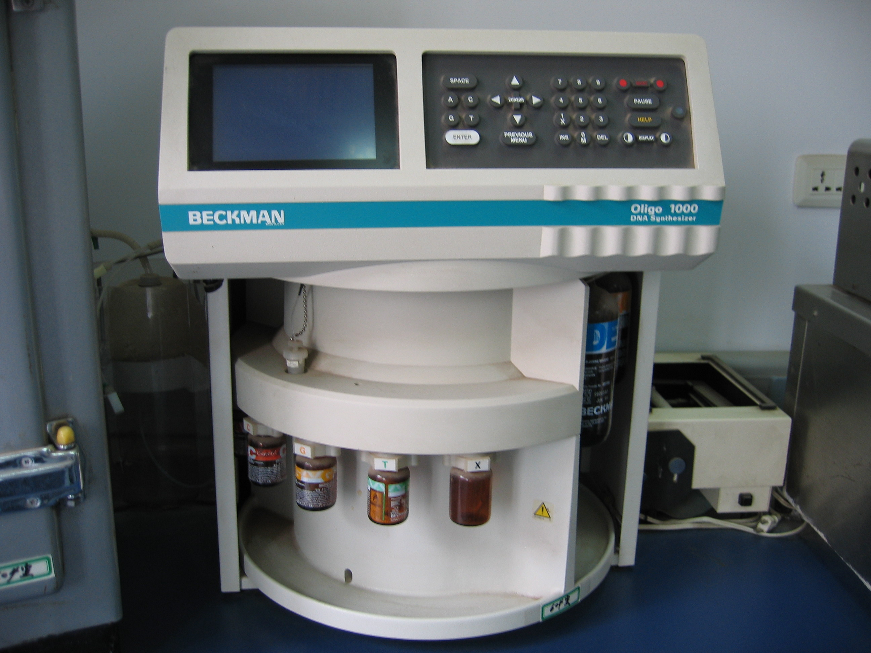
Writing DNA: Synthesis
Biology
Genome sequence
DNA
Analog
Digital (G, A, T, C)
Analog
Physical Material
Information
Physical Material
Note: this is getting cheaper to do
Note: not everyone likes this

Slide 16
Synthetic Biology
Standardization
Abstraction
Synthesis
A+A+C+T+T…
Genetic Engineering
rDNA
Sequencing
PCR

Slide 17

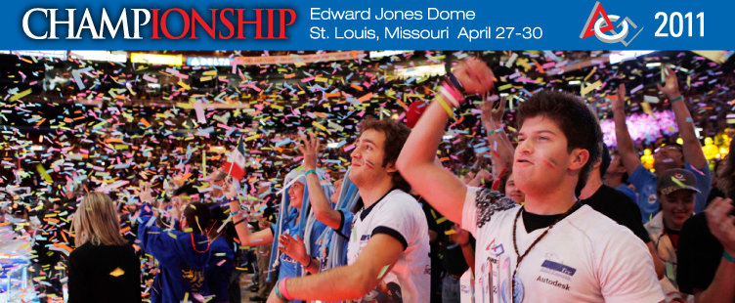
FIRST Robotics Competition
352 teams/8,800 high-school students/from five countries
■Robots are built in six weeks from a common kit of parts provided
by FIRST and weigh up to 150 lbs. ■

Slide 18
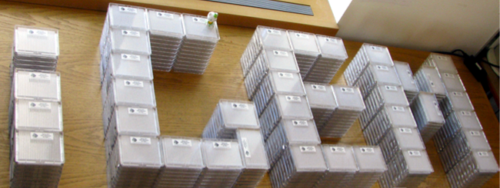

“Can simple biological systems be built from standard, interchangeable parts and operate in living cells?”
international Genetically Engineered Machines competition

Slide 19
Synthetic Biology
Standardization
Abstraction
Synthesis
A+A+C+T+T…
Genetic Engineering
rDNA
Sequencing
PCR

Slide 20
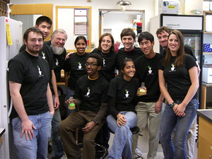
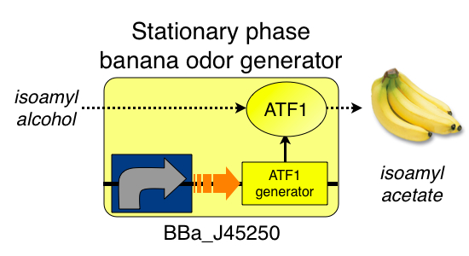
Comment from a student watching iGEM video: “The video was more than halfway over by the time I realized that BGD and WGD were actually complexes of genes, promoters, inverters, and other pieces of DNA that, when coupled together, could synthesize the chemicals needed to produce the banana and wintergreen smells. In explaining their project, the IGEM team had essentially reduced the complex process of biological manipulation to the seemingly simple matter of starting with some input (e.g. precursors) that would produce a desired output (e.g. smell).”

Slide 21
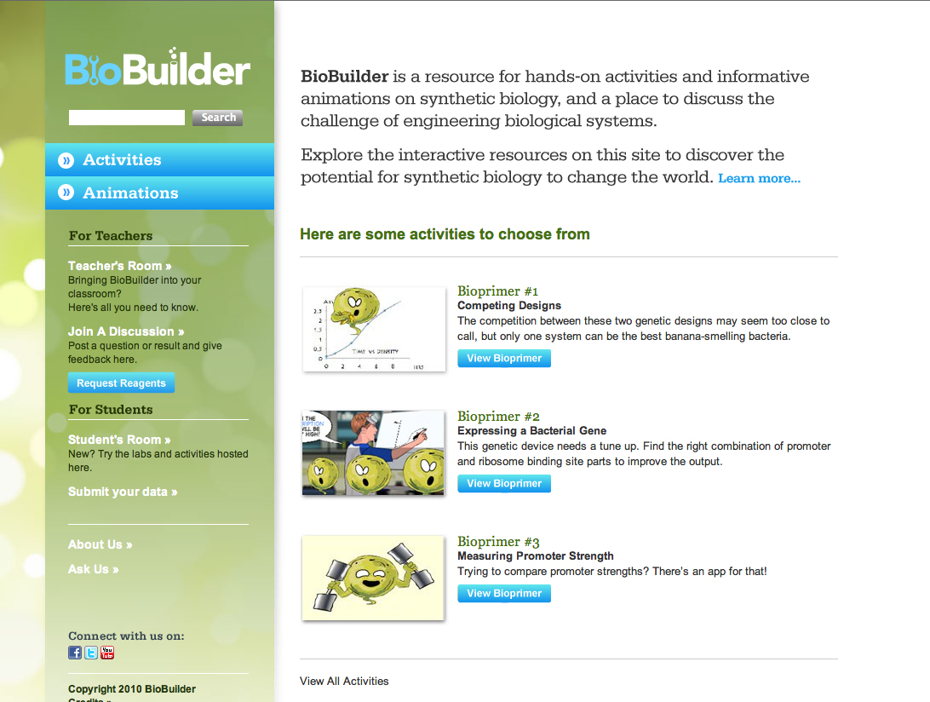

Slide 22
Introduction to Synthetic Biology
presented by Dr. Natalie Kuldell

