Slide 1
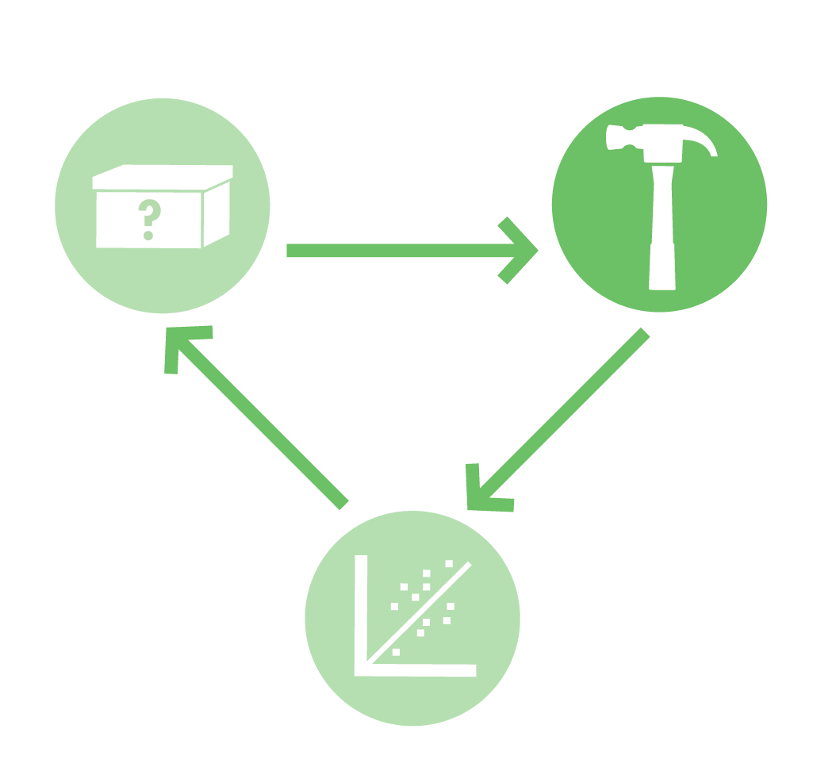
Eau That Smell
Normally stinky smelling bacteria are engineered to smell sweet. Lab activities include measurements of microbial growth, analysis of genes on a molecular level, and exploration of synthetic biology concepts related to system design and logic gates.
BioBuilder.org

Slide 2
Synthetic Biology
Synthetic Biology uses genetic engineering techniques to construct synthetic living systems
The synthetic biology approach familiarizes teachers and students with
molecular biology
genetic engineering
microbiology methods
ALL IN AN ENGINEERING SETTING
Eau That Smell | BioBuilder.org

Slide 3
Synthetic Biology: Engineering Principles
These principles and technologies extend the teaching of molecular techniques into real world, authentic applications
Eau That Smell | BioBuilder.org

Slide 4
Design
Build
Test
Eau That Smell | BioBuilder.org

Slide 5
What A Colorful World
Examines the role of the cellular chassis in system performance. Students transform different strains of E. coli with DNA that turns the cells several bright colors. Students then observe how different the color intensity can be from strain to strain, despite being encoded by the same DNA sequence.
iTUNE Device
Examines the role of parts, such as promoters and ribosome binding sites, in predicting the output of a genetic device. The students measure β-galactosidase enzymatic activity as the device’s output, thereby looking through the lens of molecular genetics to predict and then evaluate a device’s behavior.
Picture This
Three activities to explore the role of modeling in circuit design. These activities include a downloadable program to computationally vary the parameters of a genetic circuit, an exercise to mimic a genetic circuit with electronic parts, and an opportunity to send a stencil that will be turned into a bacterial photograph.
Eau That Smell
Compares two alternative genetic designs. Both programs should make the cells smell like ripe bananas as the cells grow.
Golden Bread
Explores the science, engineering and bioethics of a yeast that’s genetically modified to make a vitamin-enriched food. Lab activities include PCR, yeast transformation, codon shuffling and statistical analysis of data
Eau That Smell | BioBuilder.org

Slide 6
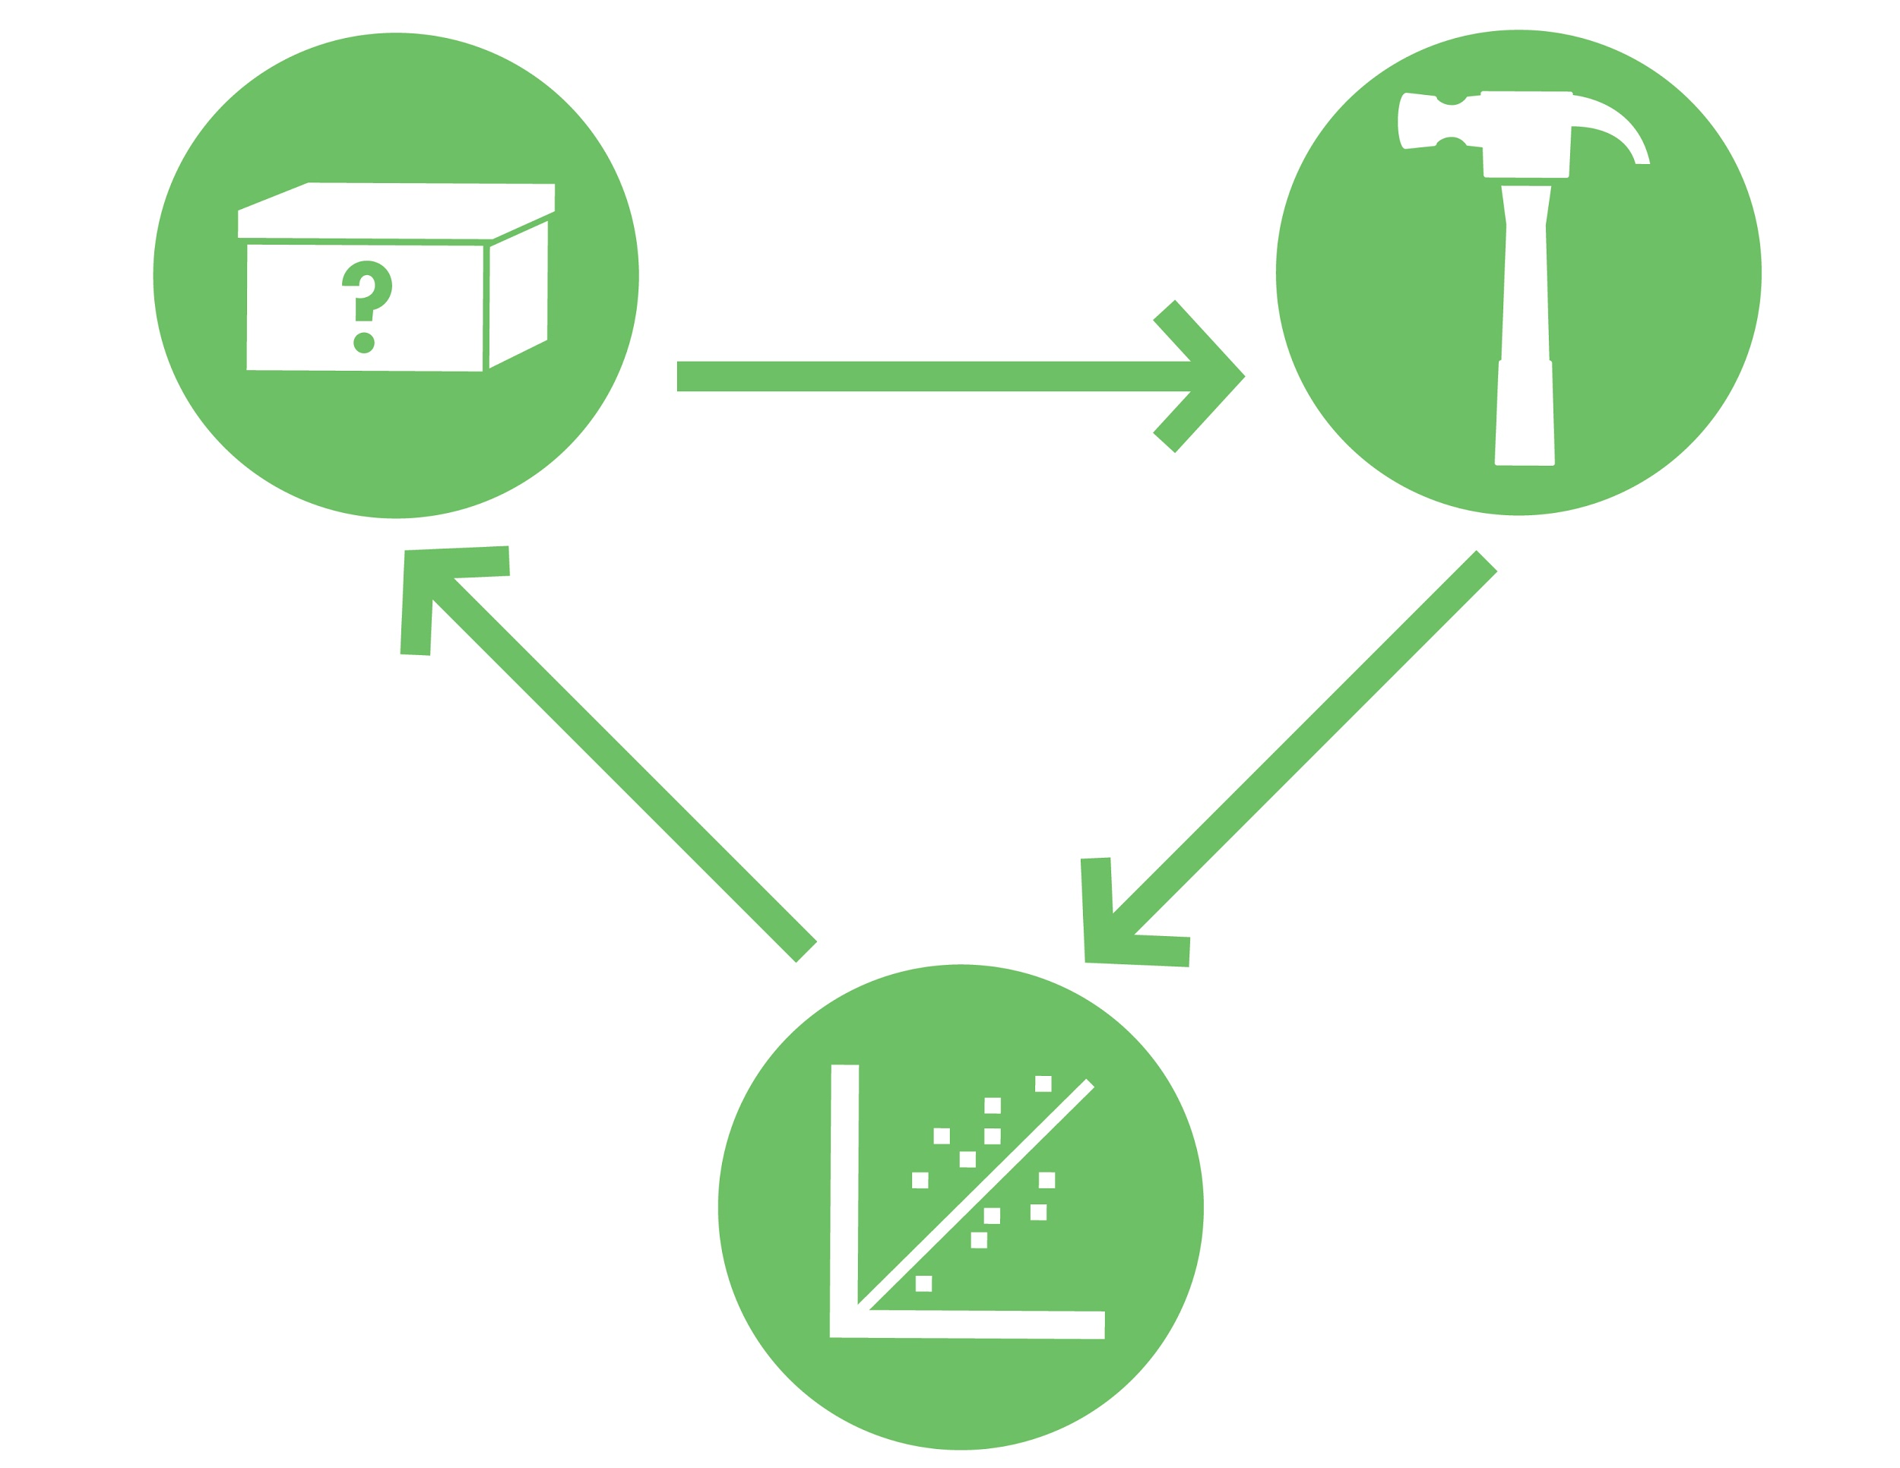
Eau that Smell
Design
Build
The engineer’s process of “design-build-test” is similar to the scientist’s method of “hypothesize, test, analyze.” Both of these approaches are often presented as linear endeavors that start with “design” for engineers and “hypothesis” for scientists, but in reality .they are iterative efforts that can begin at any point in the cycle..
Test
Eau That Smell | BioBuilder.org

Slide 7
Eau that Smell
The Eau That Smell activity emphasizes the “test” phase of the engineering design-build-test cycle, but also shines a spotlight on the design and re-design of the system being tested.
Test
Eau That Smell | BioBuilder.org

Slide 8
Eau that Smell
For this experiment, two different synthetic living systems have been designed and built by other engineers. Both of the designs change the smell of normally stinky bacteria, and both designs look like they could work.
Eau That Smell | BioBuilder.org

Slide 9
Eau that Smell
1
2
In comparing the performance of the two designs, there are opportunities to explore just how synthetic biologists make design choices as well as dive into some important scientific ideas about gene regulation and cell growth.
Eau That Smell | BioBuilder.org

Slide 10
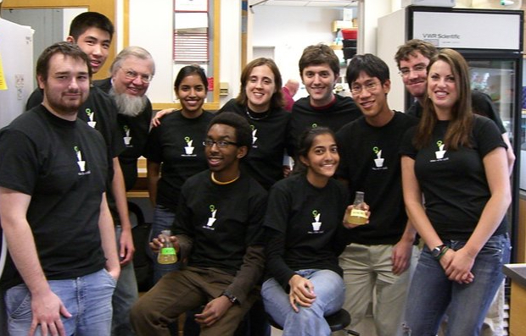
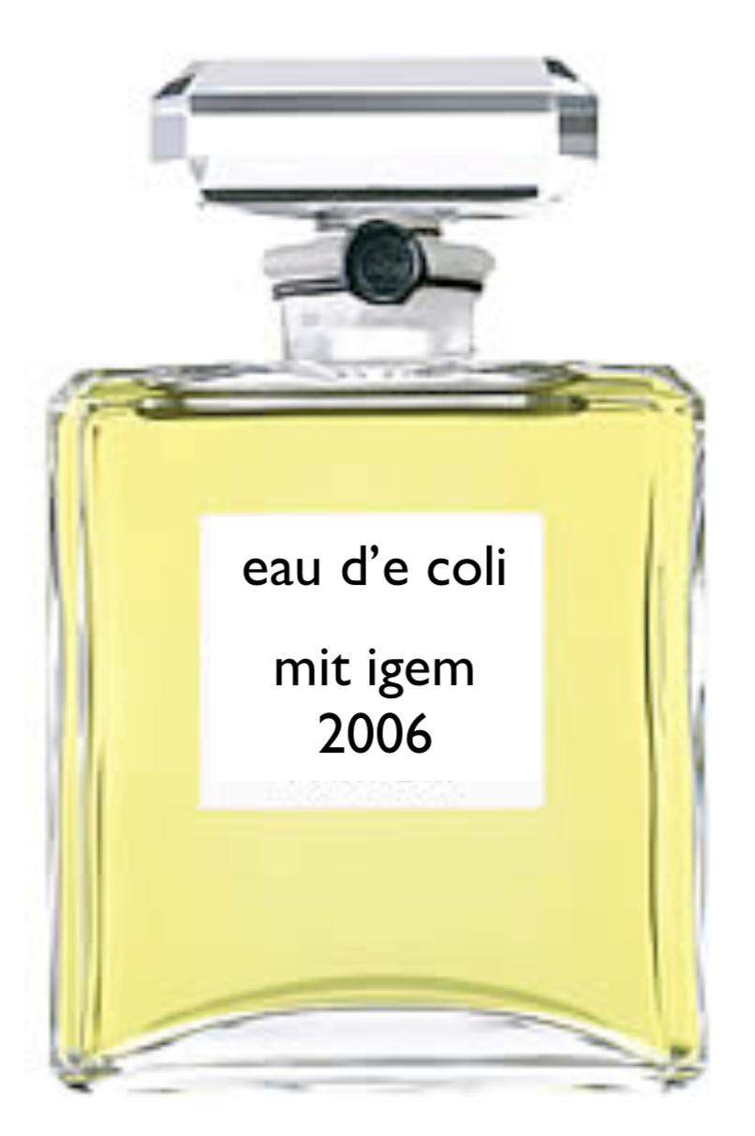
Eau that Smell
BioBuilder’s Eau That Smell activity was inspired by an International Genetically Engineered Machines (iGEM) project from 2006 in which a team of undergraduates from MIT designed a new strain of bacteria they called “Eau d’coli.” The MIT team built a strain of E. coli that gave off sweet smells, like wintergreen or ripe bananas, depending on the growth phase of the cells.
Eau That Smell | BioBuilder.org

Slide 11
Eau that Smell
The 2006 MIT iGEM team began their Eau d’coli project with a simple observation:
E. coli smell really bad.
They decided to introduce a new, more pleasant scent into bacteria so the engineered cells could smell nice instead of stinky.
Eau That Smell | BioBuilder.org

Slide 12
Eau that Smell
Having identified the challenge they wanted to address, they could then specify a system-level design. They decided that the bacteria could be engineered to convert a precursor compound in the media into a nice smelling output.
Eau That Smell | BioBuilder.org

Slide 13
Eau that Smell
To realize their system design, the team looked for some genetic devices that could turn a non-smelling precursor compounds into a pleasant scent. They found several by searching the scientific literature and then they tried some preliminary experiments to narrow down their ideas.
Eau That Smell | BioBuilder.org

Slide 14
Eau that Smell
To realize their system design, the team looked for some genetic devices that could turn a non-smelling precursor compound into a pleasant scent. They found several by searching the scientific literature, and then they tried some preliminary experiments to narrow down their ideas.
Eau That Smell | BioBuilder.org

Slide 15
Eau that Smell
At this point, the team could have started to work on their parts-level design and then built and tested their system.
Eau That Smell | BioBuilder.org

Slide 16
Eau that Smell
Instead, the team decided to revise their system-level design so the cell could switch between the two smell outputs. The team went back to the drawing board and modified their original design goal of making a better smelling bacteria.
Eau That Smell | BioBuilder.org

Slide 17
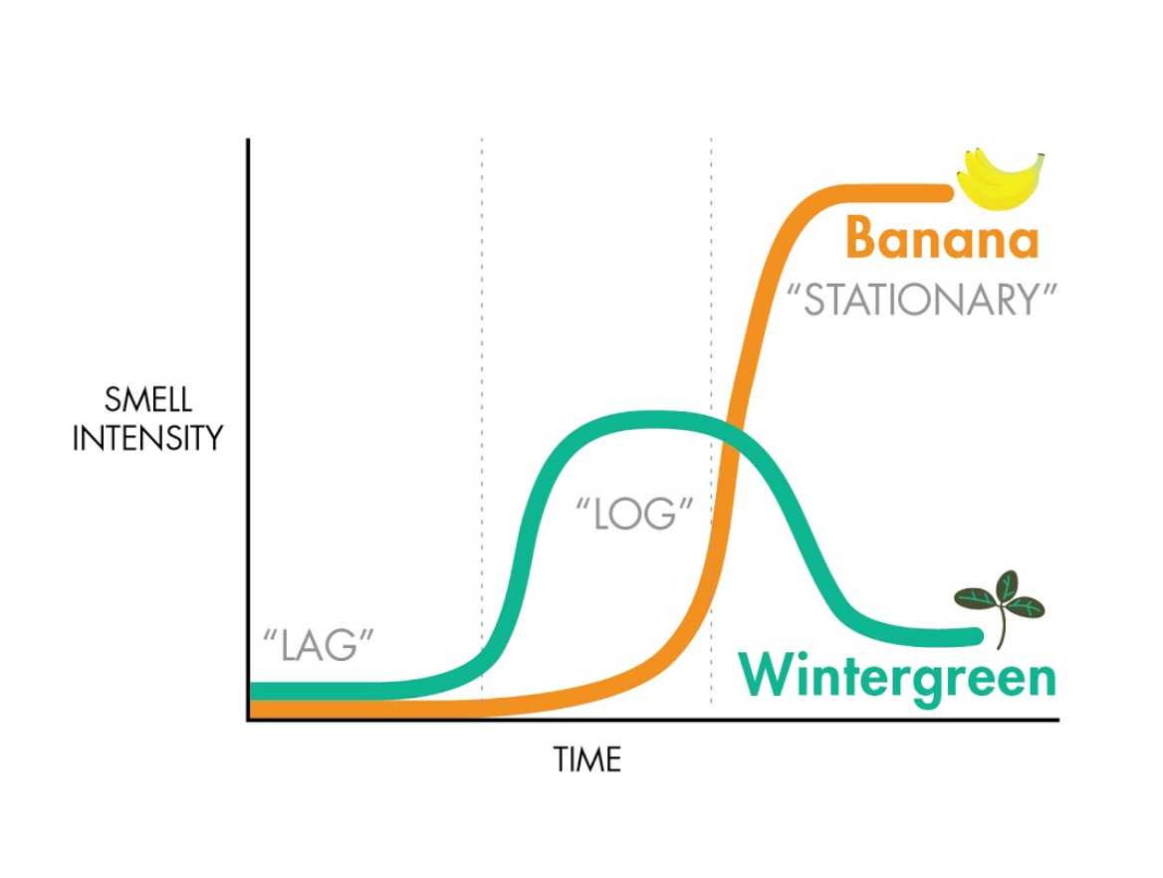
Eau that Smell
They redesigned their system so cells would have one kind of smell when the cells were actively dividing and another smell when the cells reached their maximal density.
Eau That Smell | BioBuilder.org

Slide 18
Eau that Smell
With this modification to the system’s design, the team went on to build the first synthetic living system that used scent as a reporter for cell growth.
Eau That Smell | BioBuilder.org

Slide 19
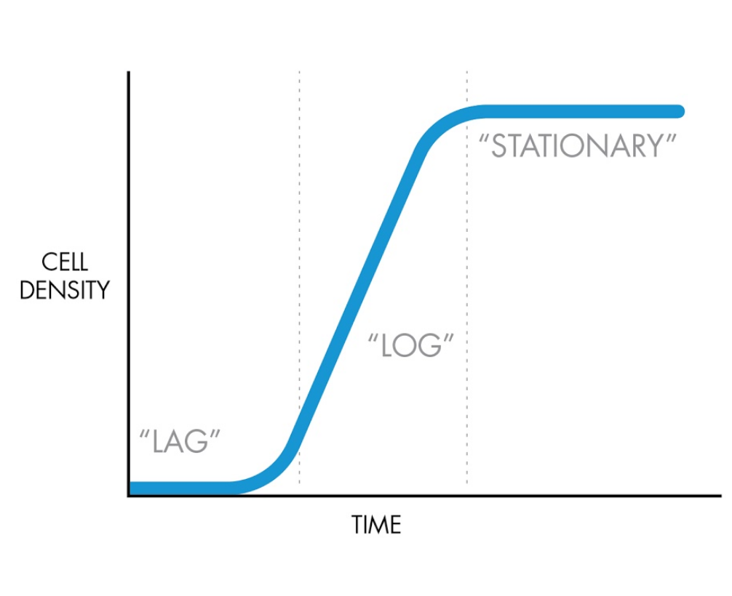
Eau that Smell
Cell populations follow a predictable growth pattern. When cells are introduced into fresh media, they spend time in what’s called “.lag phase .” During this time, the cells are getting acclimated to the new media, but they are not dividing. Consequently, the # of cells/unit of volume, aka the cell density, does not increase and the growth curve is flat.
Eau That Smell | BioBuilder.org

Slide 20
Eau that Smell
During the lag phase, cells are being primed for growth, and when they are ready to divide, they enter “.log phase ” (also called “exponential phase”). During this phase of growth, the number of cells increases quickly. At 37°C, bacterial cells can double every 30 minutes or so. The log phase of the growth curve shows an increase in the density of cells over time.
Eau That Smell | BioBuilder.org

Slide 21
Eau that Smell
As the cells get crowded and the media gets used up, the rate of cell division slows down and then stops. During this “.stationary phase ” of growth, the density of the culture does not increase. The cells are alive, however, and can enter lag phase again if they are diluted into fresh media.
Eau That Smell | BioBuilder.org

Slide 22
Eau that Smell
Researchers often measure cell density using a spectrophotometer. This instrument detects the amount of light that can pass through a sample. The difference between the amount of light that enters a sample and the amount that exits is called the optical density. The optical density increases as the density of cells increases.
Eau That Smell | BioBuilder.org

Slide 23
Eau that Smell
The MIT iGEM team wanted to change their system so the smell-generating devices could respond to cell growth phase. In particular they wanted the wintergreen scent to be produced in log phase and the banana scent to be produced in stationary phase.
Eau That Smell | BioBuilder.org

Slide 24
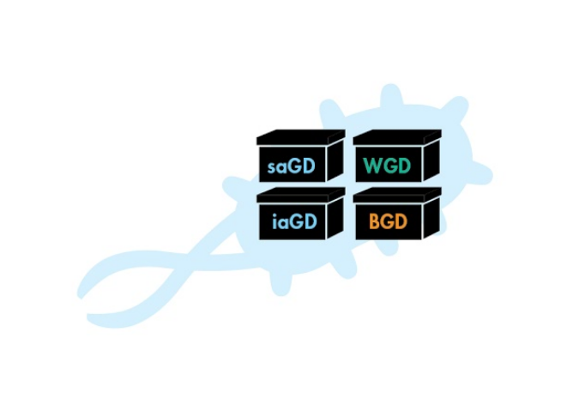
Eau that Smell
To accomplish this new system specification, the team needed to re-engineer the cells in three ways.
1
The cells were re-engineered to include additional devices that made the smell precursor molecules. Precursors did not have to be added to the growth media since the cells could make them from natural starting materials already inside the cells.
Eau That Smell | BioBuilder.org

Slide 25
Eau that Smell
2
The cells were re-engineered so the scent production was controlled at the level of transcription. In particular, the banana-scent was transcribed from a promoter called PosmY, which is most active during the stationary phase of growth. Similarly, the wintergreen-scent was controlled at the transcriptional level. The MIT iGEM team chose to re-use the PosmY promoter to express the wintergreen scent, but they added a genetic inverter device (also called a NOT logic gate). This design was intended to restrict the wintergreen scent to growth phases that are NOT stationary phase.
Eau That Smell | BioBuilder.org

Slide 26
Eau that Smell
3
CHASSIS ENGINEERING
The third aspect of the system that the MIT iGEM team re-designed was the bacterial chassis itself. This redesign came about because in early tests of their system, they noticed that the natural stinkiness of the strain was overwhelming the banana and wintergreen smells. They researched the genetic origins of the strain’s terrible smell and found that bacteria produce a smelly compound called indole. Deletion of the tryptophanase gene led to an indole-deficient chassis that had a much less pungent stink. This chassis was used for all later experiments.
Eau That Smell | BioBuilder.org

Slide 27
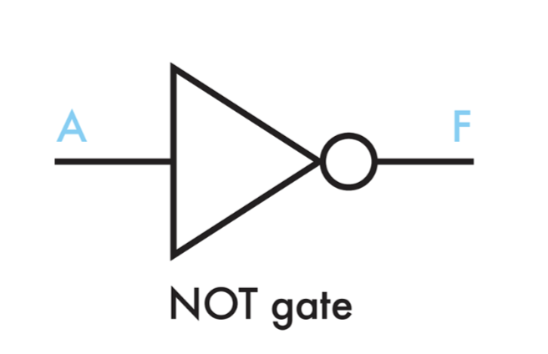
Eau that Smell
INTRODUCTION TO LOGIC GATES
When the MIT iGEM wanted to control the wintergreen scent, they deployed a concept that is more commonly found in electrical engineering. The team used a digital inverter device, aka a NOT gate, to construct a genetic digital circuit. The operation of logic devices, also sometimes called Boolean logic gates, can be described using truth tables. These tables represent all possible combinations of inputs and specify a single output for each combination.
Eau That Smell | BioBuilder.org

Slide 28
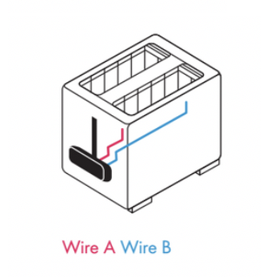
Eau that Smell
In electrical engineering, the inputs might be electrical signals from wires and the output might be a third electrical signal that does some function, such as turning on your toaster. In synthetic biology, logic gates are built out of DNA using control elements and products from natural genetic circuits. Inputs might be environmental stimuli, such as sugar, pH, heat or cell density. The output might be a fluorescent reporter such as GFP, or a molecule of interest such as a medicine, biofuel or scent.
Electrical Engineering
Synthetic Biology
Eau That Smell | BioBuilder.org

Slide 29
Eau that Smell
LOGIC GATES IN THE CONTEXT OF EAU D’COLI
The 2006 MIT iGEM team wanted to express the wintergreen scent in the log phase of growth. To accomplish this design, they paired the PosmY stationary phase promoter with a genetic NOT gate that could invert the natural pattern of gene expression from PosmY. The truth table (below) shows the on/off states for the outputs with and without the inverting NOT gate.
Eau That Smell | BioBuilder.org

Slide 30
Eau that Smell
By combining the stationary-phase promoter and a genetic NOT gate, the wintergreen scent was expressed whenever the banana scent wasn’t.
Eau That Smell | BioBuilder.org

Slide 31
Eau that Smell
BIOBUILDER’S EAU THAT SMELL ACTIVITY
BioBuilder’s Eau That Smell activity extends the work of the 2006 MIT iGEM team, looking at different ways to control the relationship between cell growth and scent generation. In this activity, the system has been re-engineered once again. The strain has no wintergreen scent production and the banana scent is re-designed to express during the log phase of growth, rather than the stationary phase. .The goal with this experiment is to compare two designs for making banana scent during log phase.. On paper, the two design options appear nearly equivalent, but real-world behavior often deviates from expectations, and this laboratory activity allows for direct testing of the differently designed strains.
Eau That Smell | BioBuilder.org

Slide 32
Eau that Smell
Design 1
Design 2
Expresses the banana scent using a stationary phase promoter and an inverting NOT gate
Expresses the banana scent using a log phase promoter and no logic gate
Eau That Smell | BioBuilder.org

Slide 33
Eau that Smell
MEASURING SCENT PRODUCTION
To simplify the genetics of the strains, the precursor molecule for the banana scent will be added to the media rather than be produced by the cell itself. This change may impact the smell of the media, but it will do so with all the strains tested. All strains are indole-deficient to alleviate the strain’s natural stink.
Eau That Smell | BioBuilder.org

Slide 34
Eau that Smell
To measure the amount of banana scent, smell tests will be carried out at each stage of growth. The original Eau d’coli strain will provide a POSITIVE CONTROL FOR SCENT since this strain is known to produce banana scent during the stationary phase of growth. The indole-deficient strain with no scent generating devices will serve as a NEGATIVE CONTROL FOR SCENT.
Banana oil will be diluted to make banana scent standards. Because everyone will use these standards, the amount of smell can be described using a shared measurement scale.
Eau That Smell | BioBuilder.org

Slide 35
Eau that Smell
TWO PROTOCOLS
The basic version of this protocol involves pre-growing the strains to .lag., .log. and .stationary. phase. The activity emphasizes data analysis over data collection. A longer version of the protocol follows the strains through the three stages of growth, enabling growth curve-data collection as well as scent measurements.
Eau That Smell | BioBuilder.org

Slide 36
Good Luck!
BioBuilder.org

